Slide 1
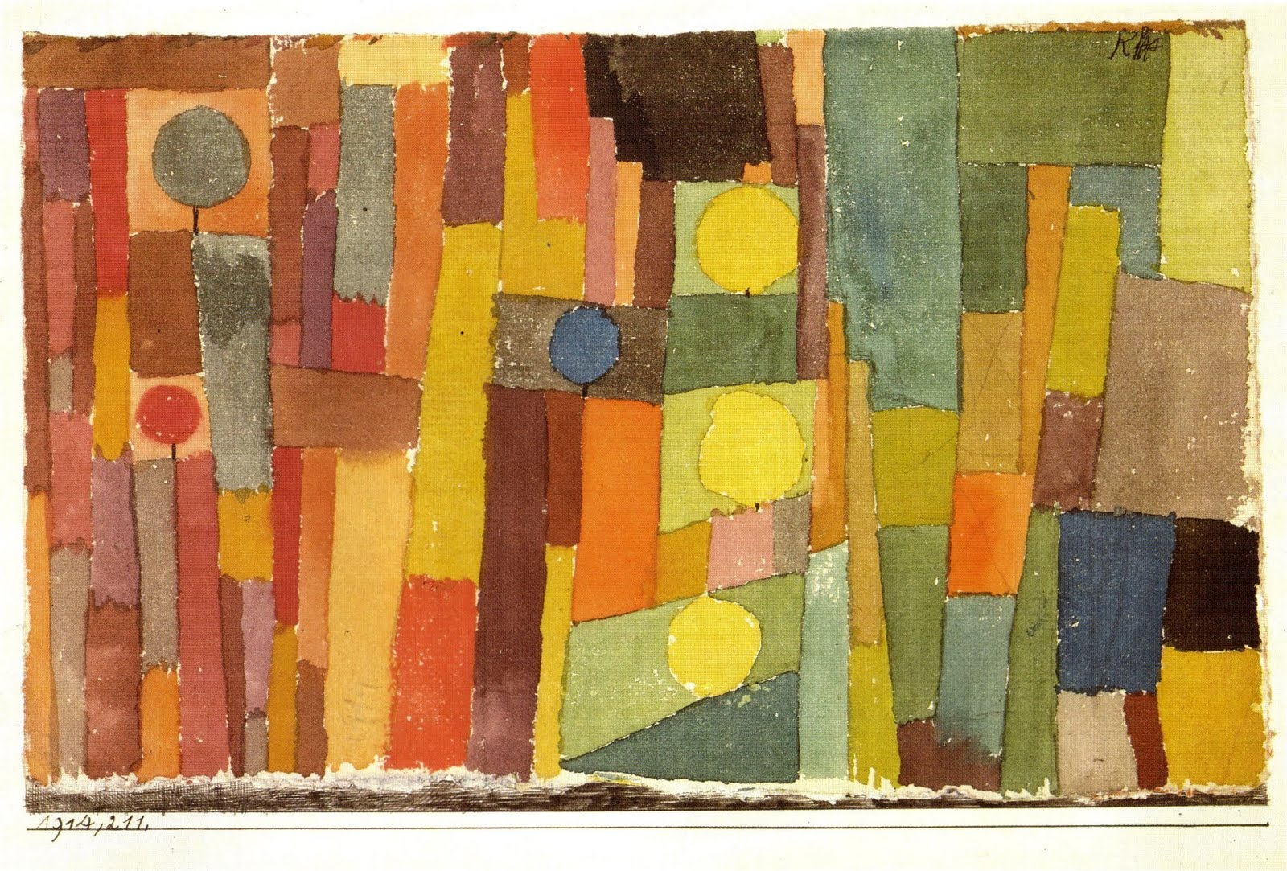
In the Style of Kairouan 1914

Slide 2
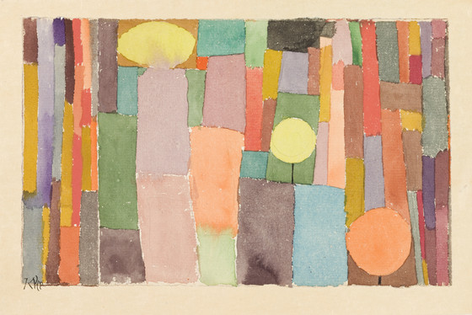
In the Kairouan Style, Transposed in a Moderate Way, 1914

Slide 3
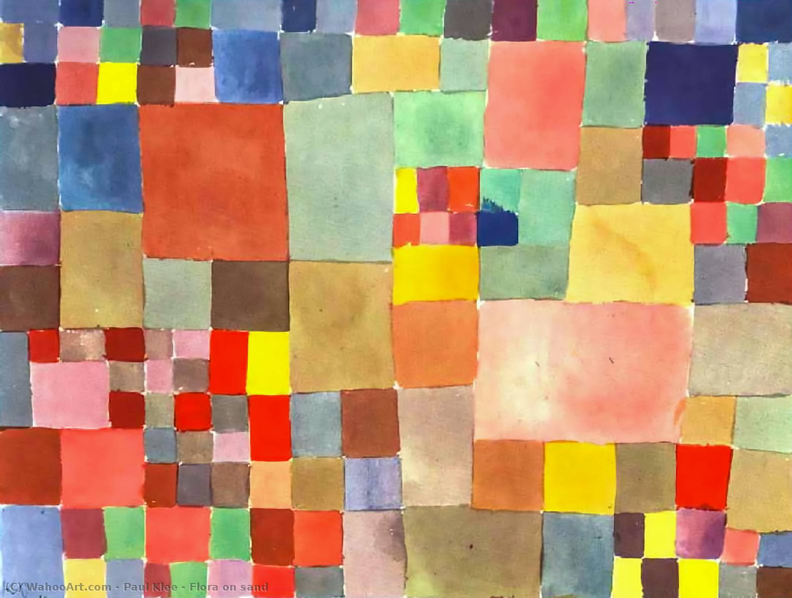
Flora on Sand, 1927

Slide 4
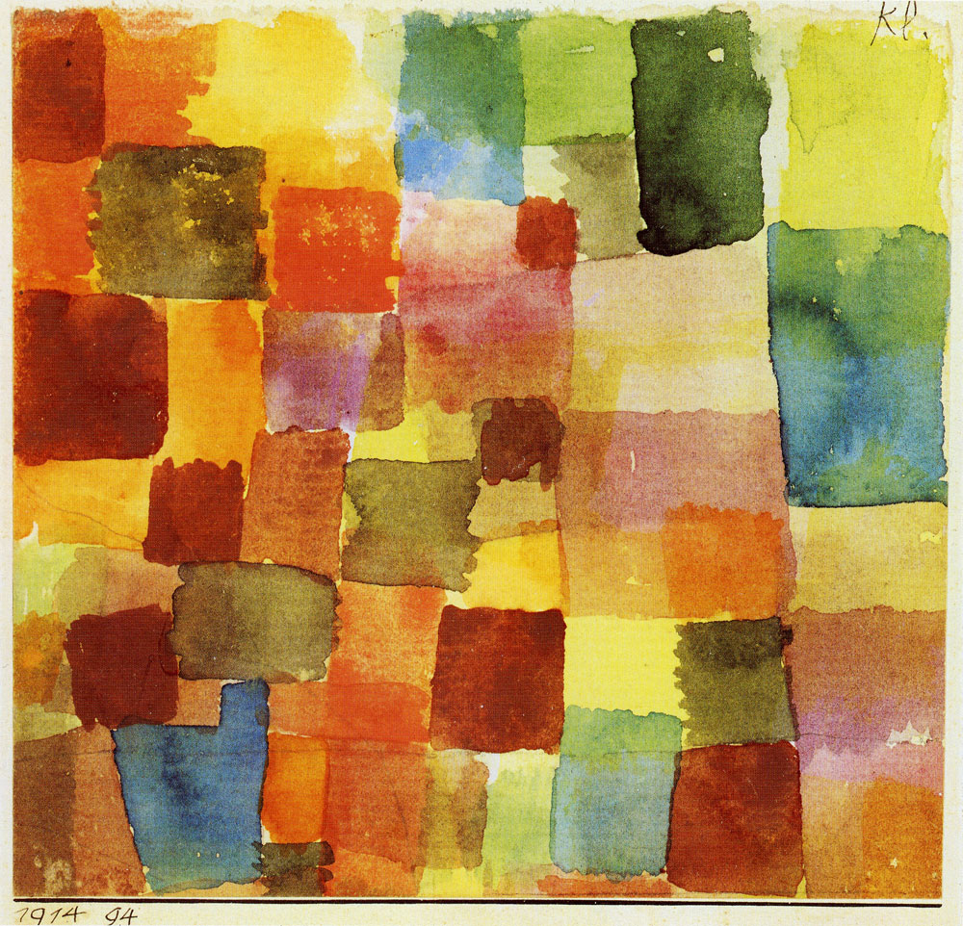
Aquarelle, 1914

Slide 5
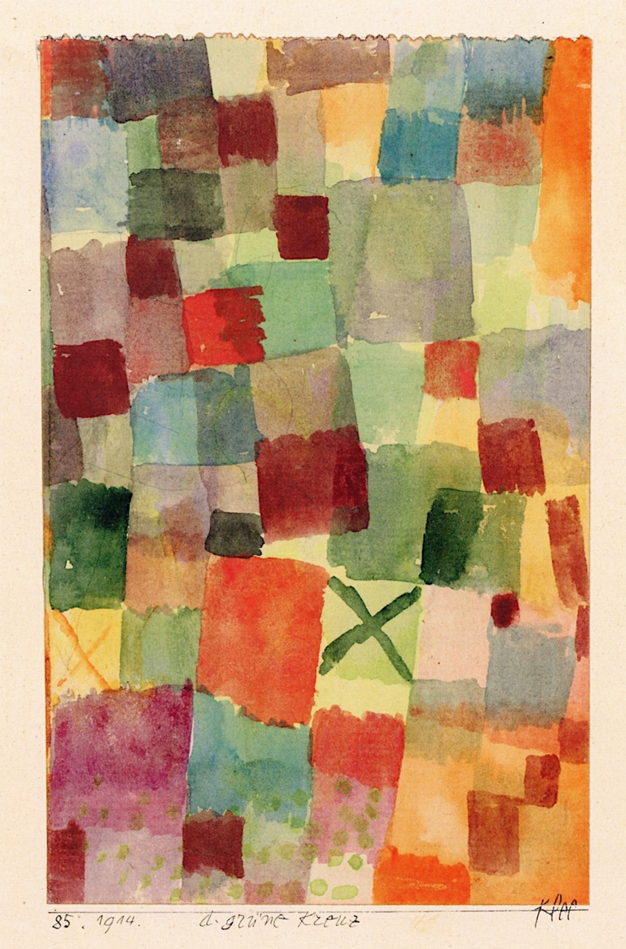
Watercolour with Dark Green Cross, 1914

Slide 6
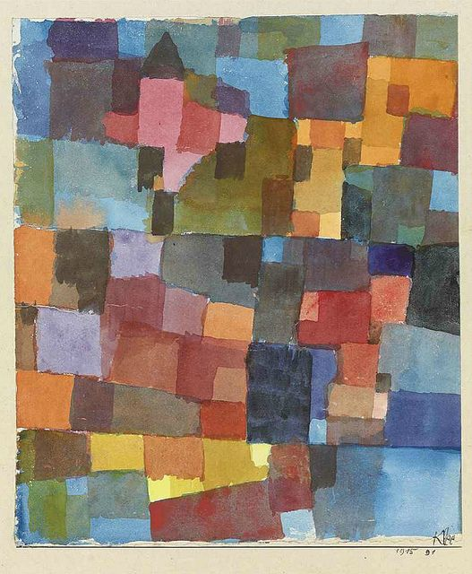
Cityscape with Yellow Windows, 1919

Slide 7
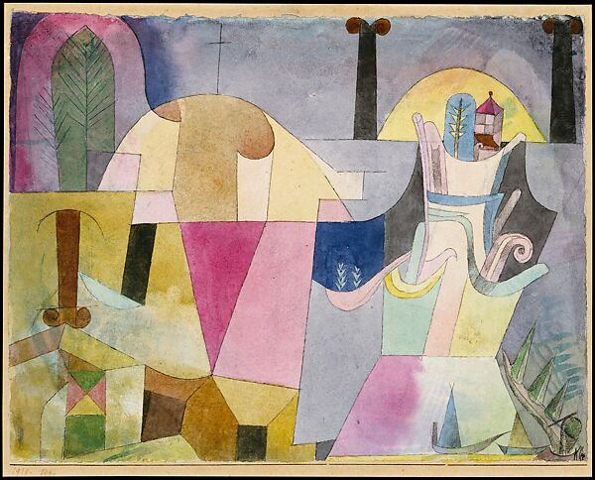
Black Columns in a Landscape, 1919

Slide 8
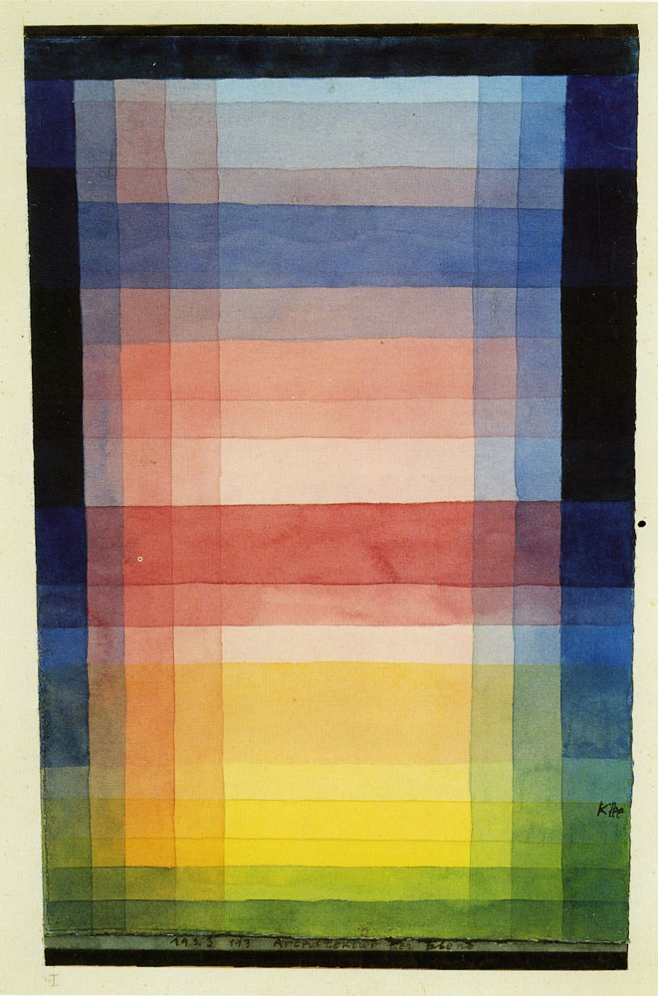
Architecture of the Plain, 1923

Slide 9
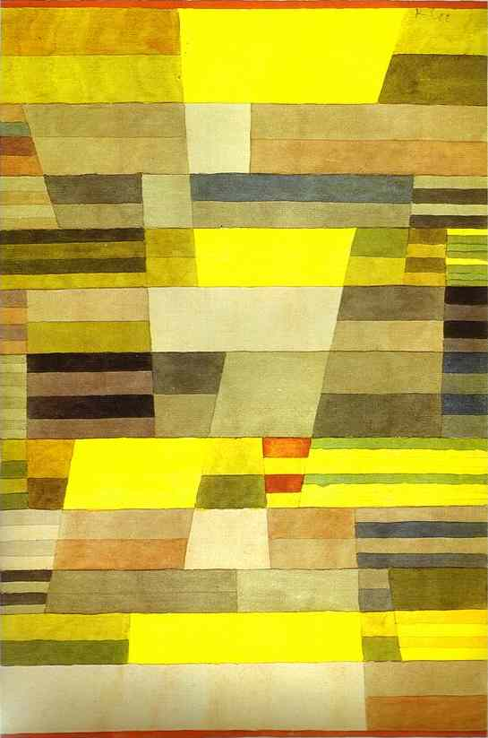
Monument, 1929

Slide 10
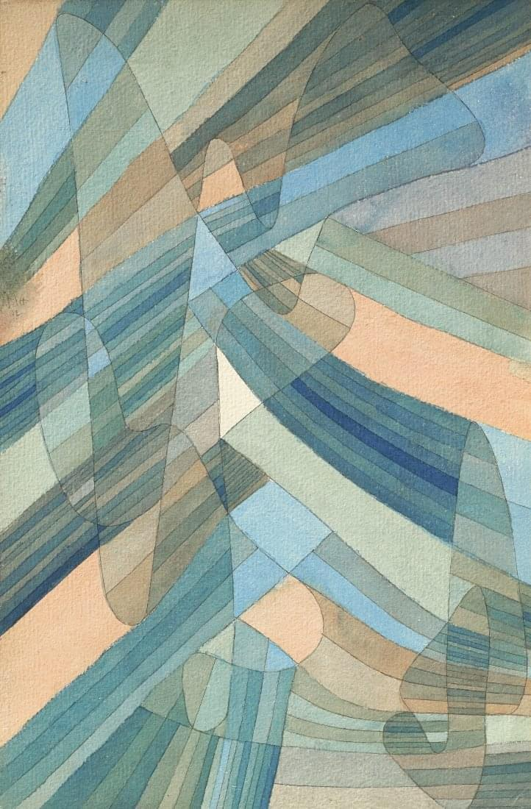
Polyphonic Currents, 1929

Slide 11
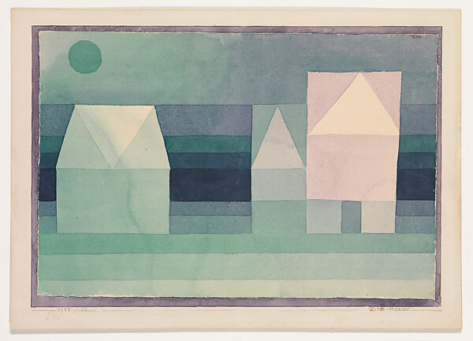
Three Houses, 1923

Slide 12
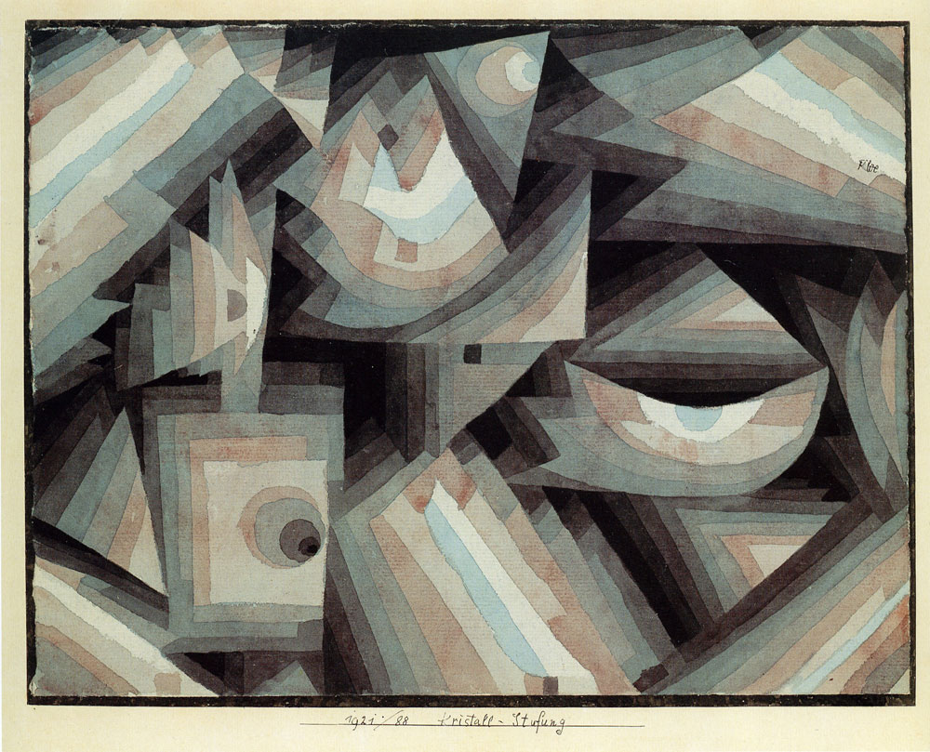
Crystal Gradation 1921

Slide 13
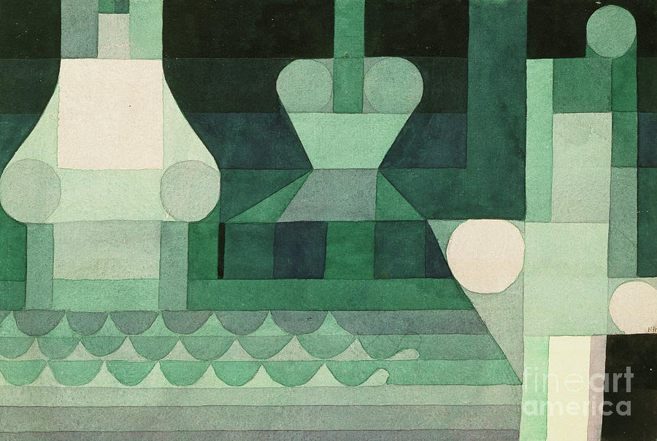
Flood Gates, 1922

Slide 14
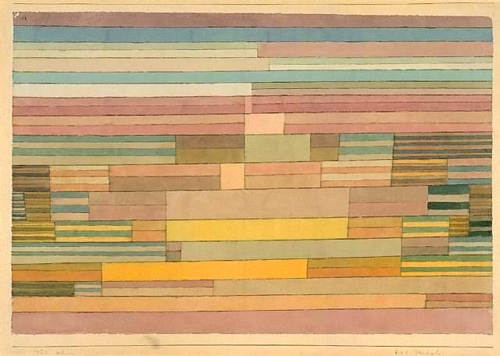
Upper Egypt, 1929

Slide 15
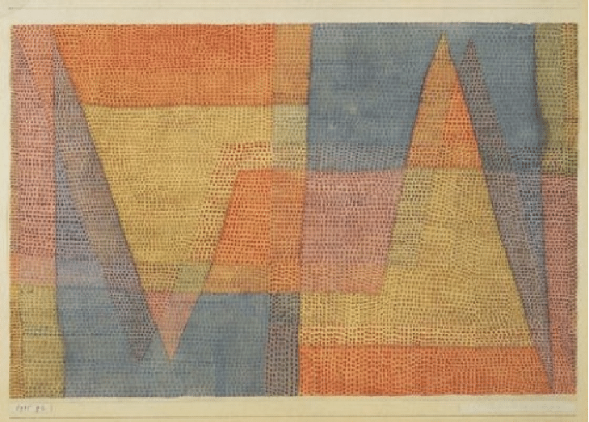
Light and Sharpness 1935

Slide 16
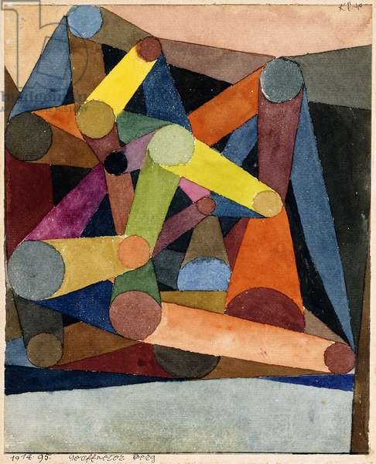
Open Mountain, 1914

Slide 17
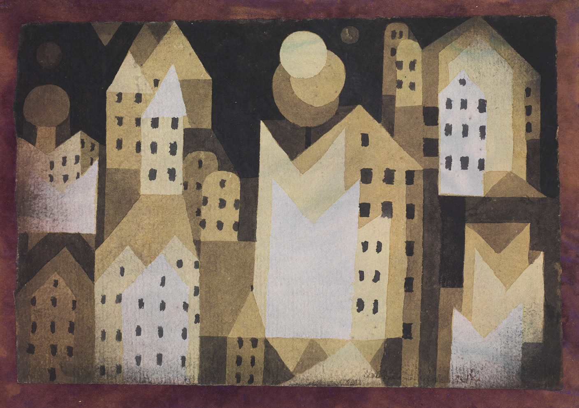
Cold City 1926

Slide 18
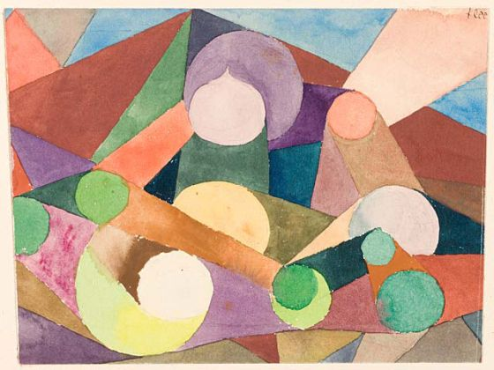
Motion of a Landscape 1924

Slide 19
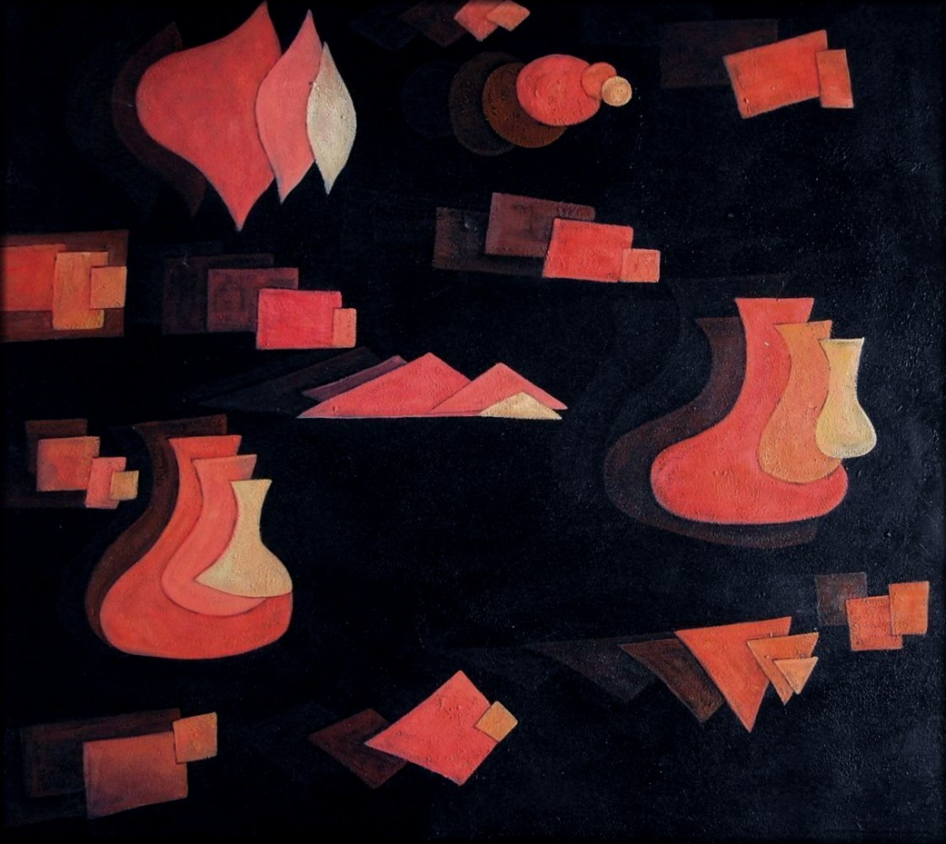
Fugue in Red, 1921

Slide 20
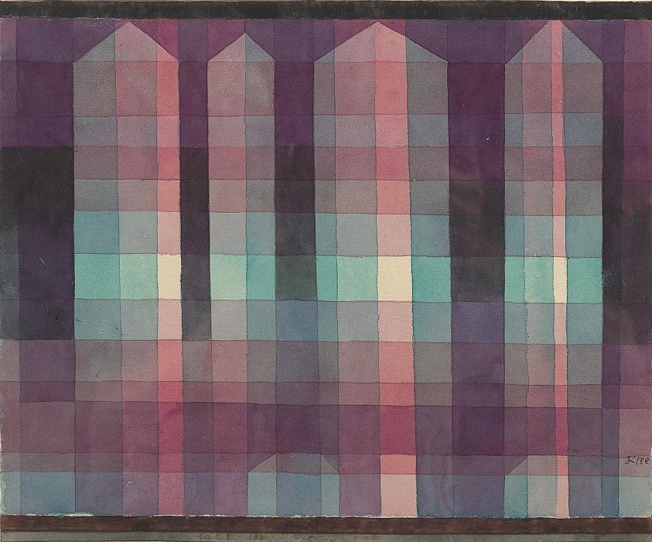
Four Towers, 1923

Slide 21
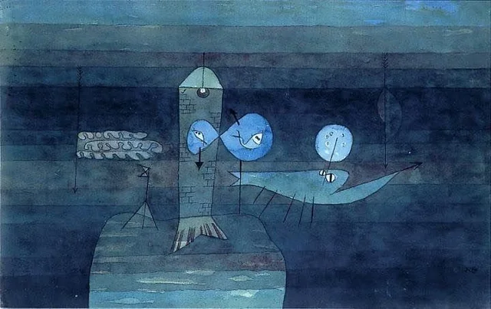
Good Place for Fish, 1922

Slide 22
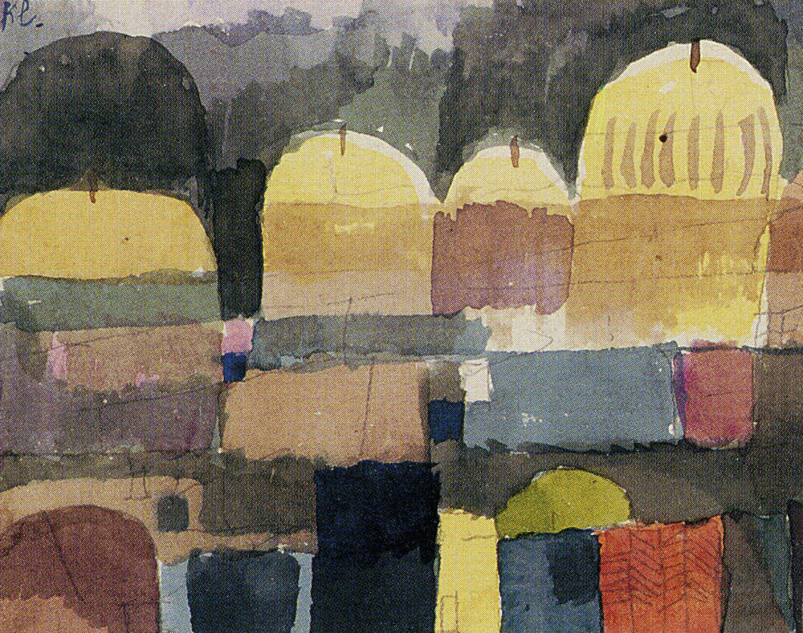
Oriental watercolour, 1914

Slide 23
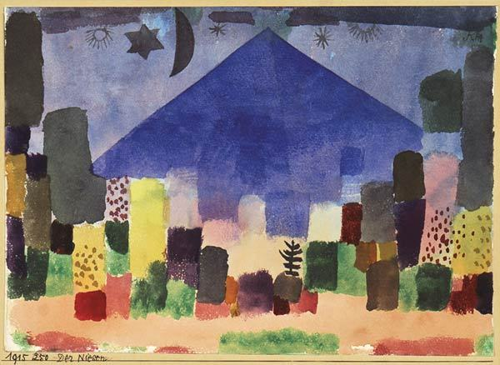
Mount Niesen 1915

Slide 24
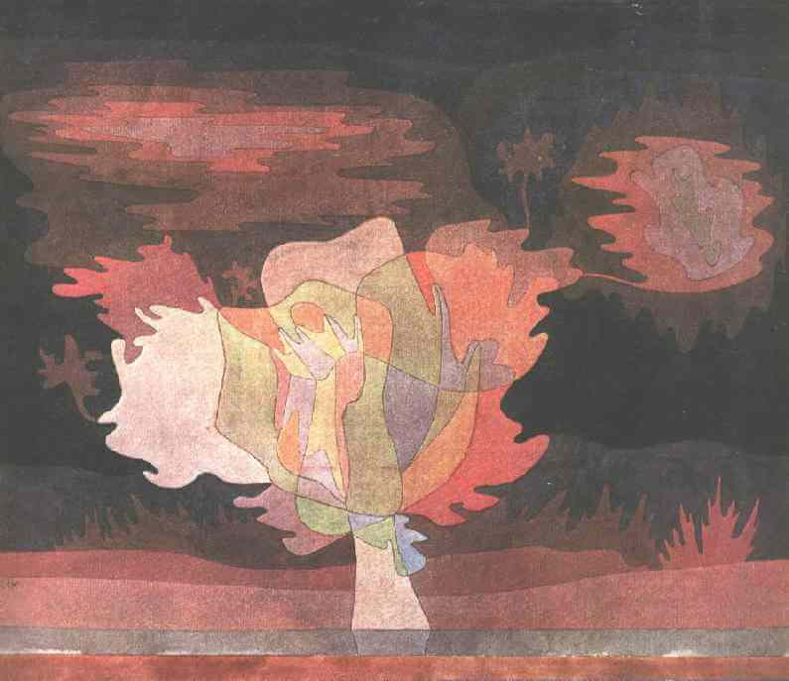
Before the Snow, 1929

Slide 25
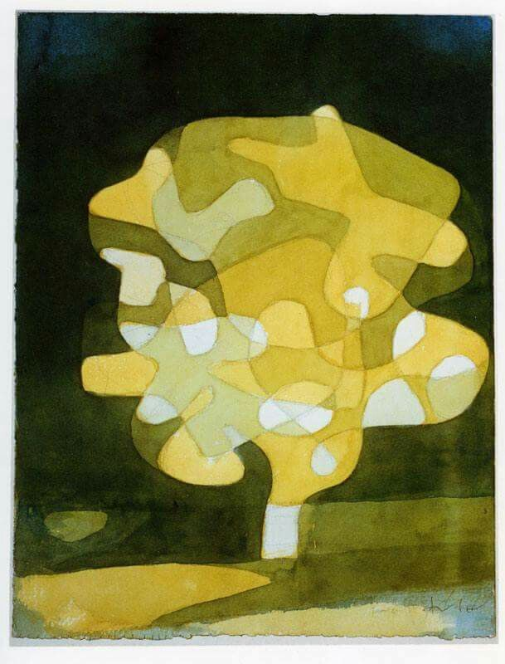
Fig Tree 1929

