Slide 1
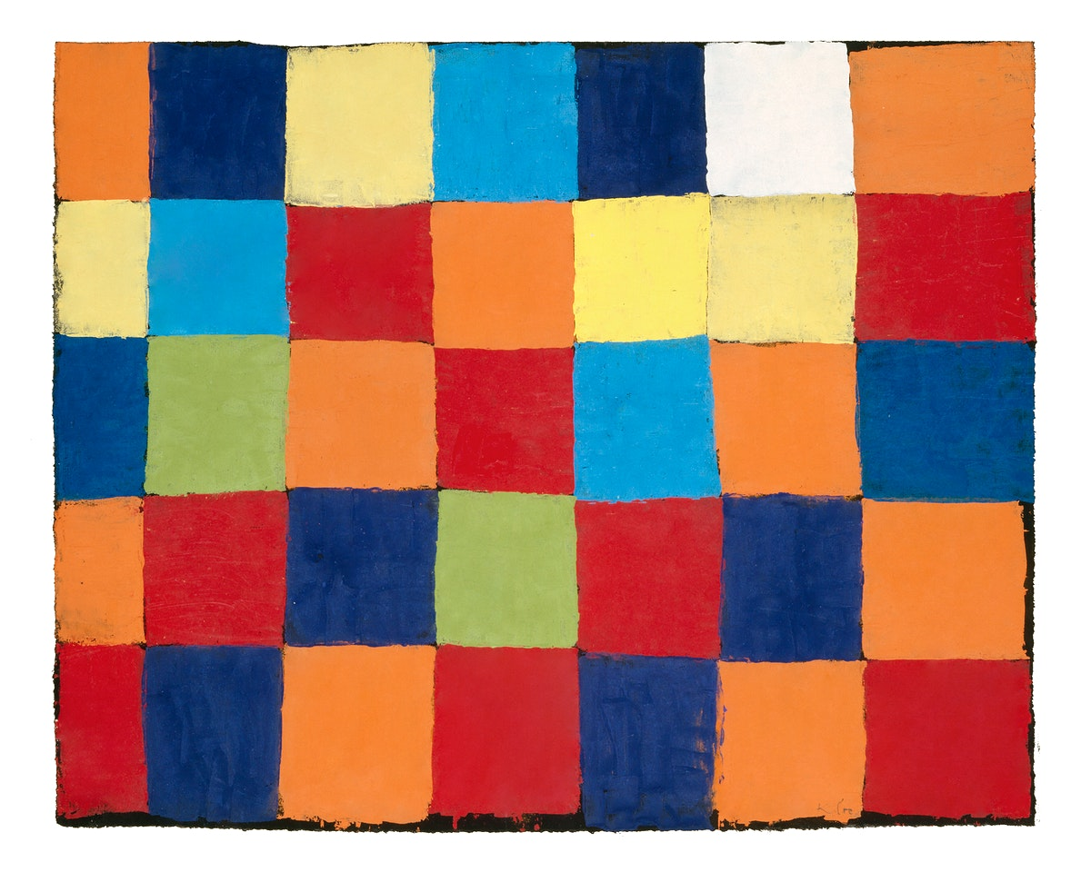
Paul Klee
1906-1940

Slide 2
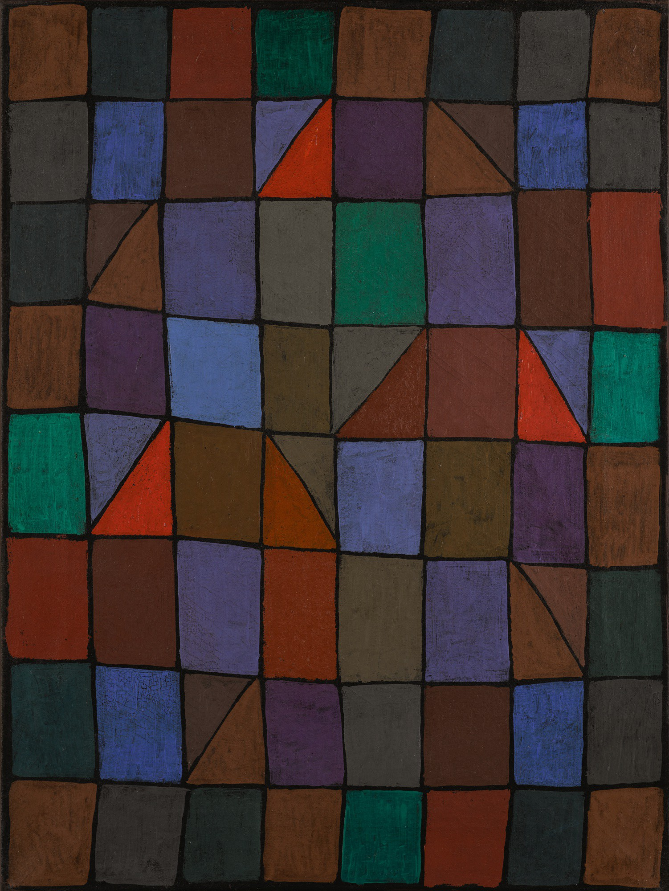

Slide 3
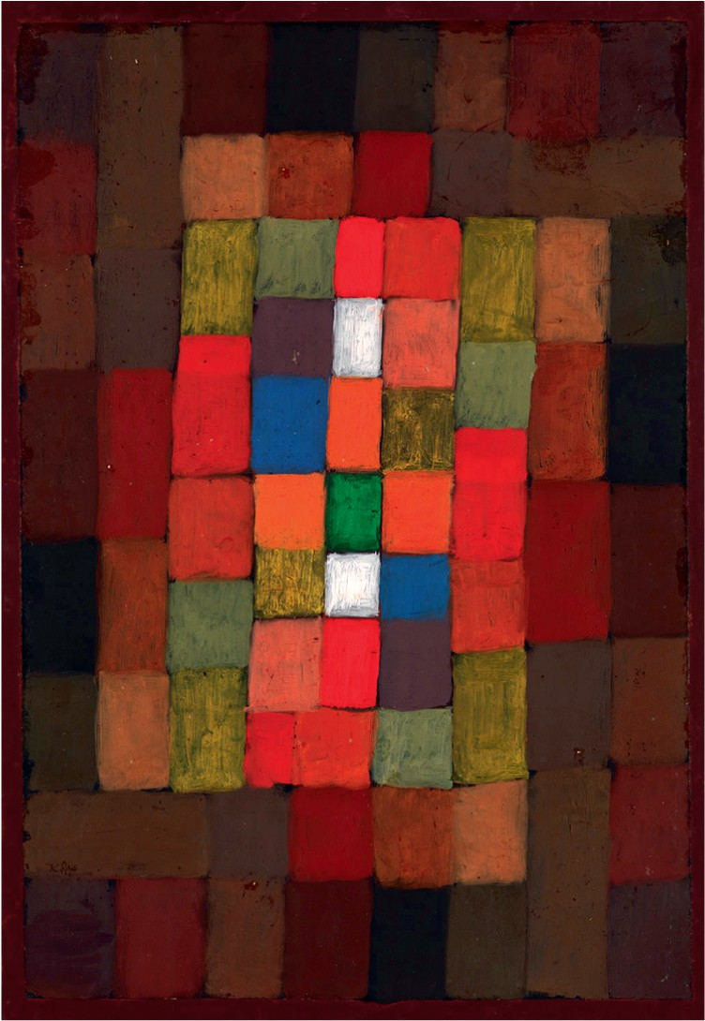

Slide 4
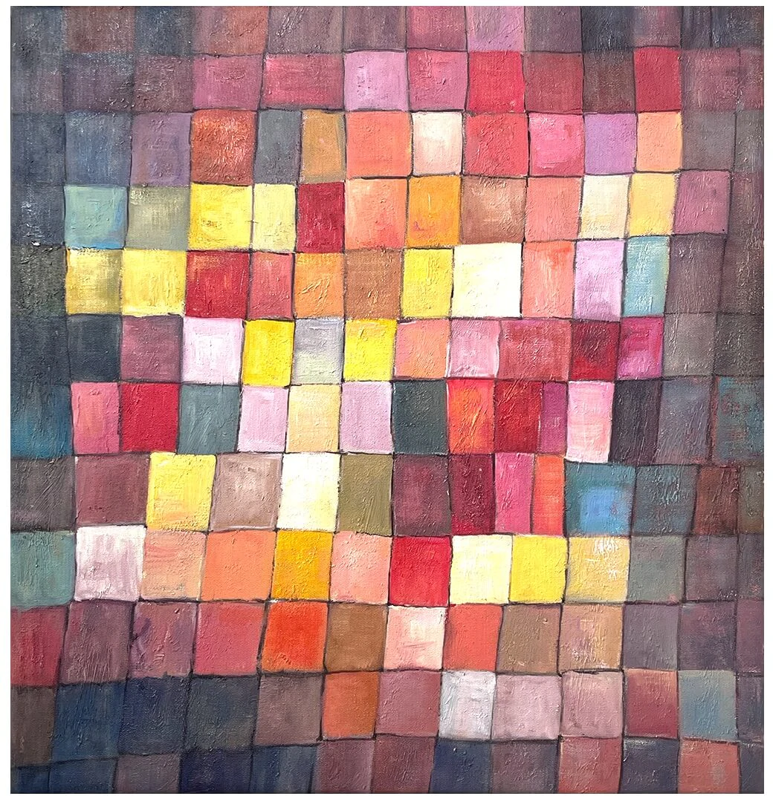

Slide 5
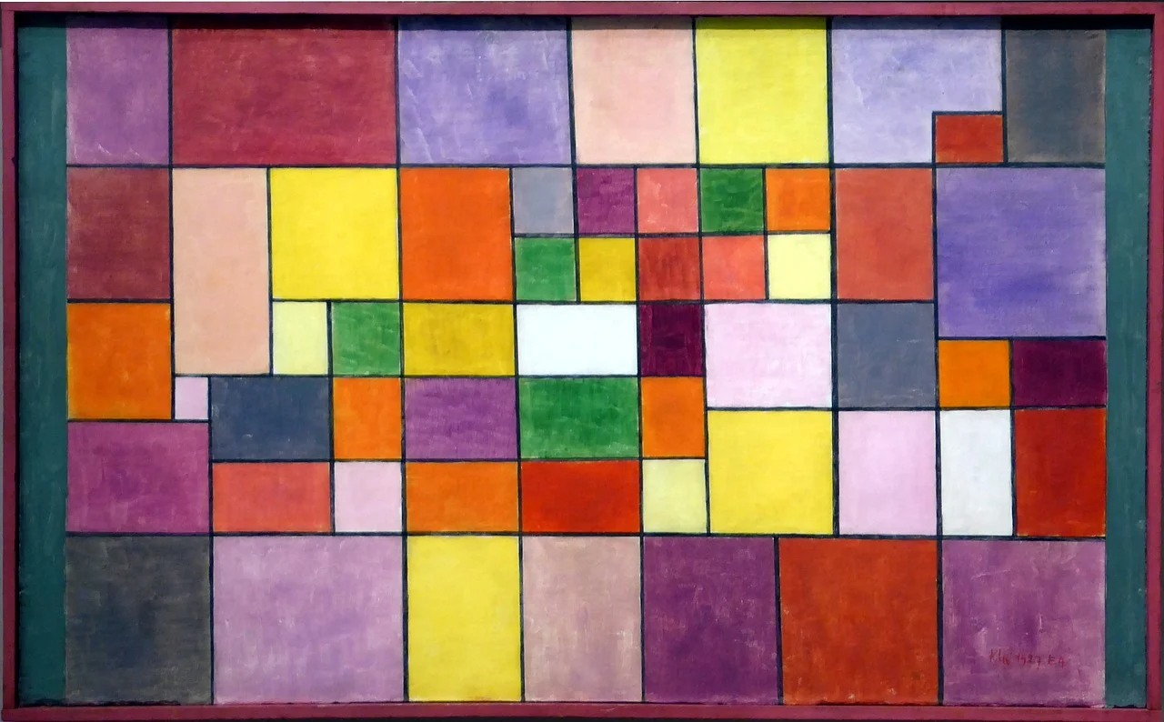

Slide 6
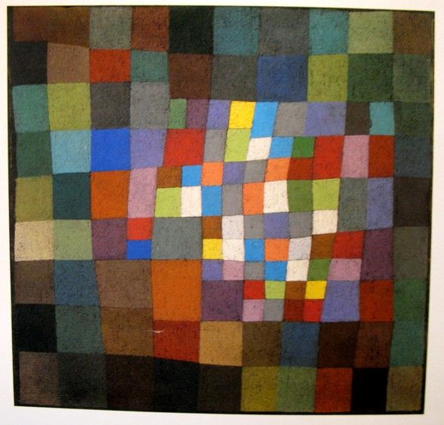

Slide 7
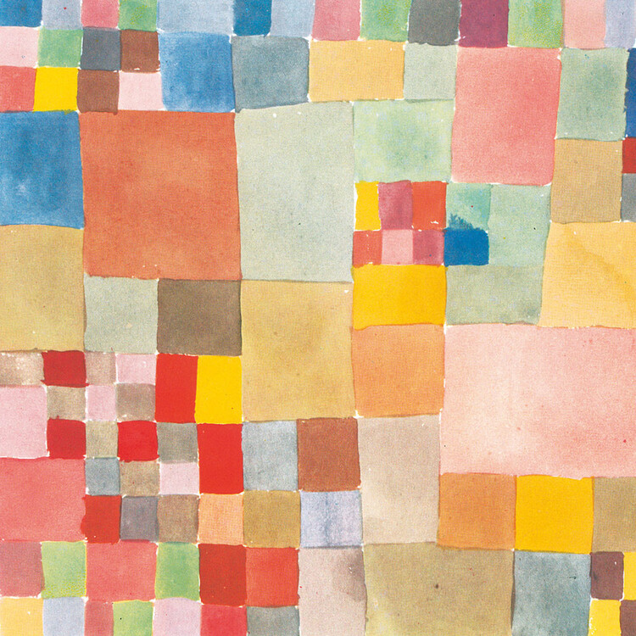

Slide 8
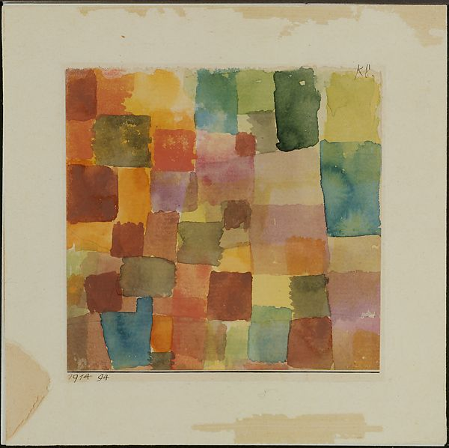

Slide 9
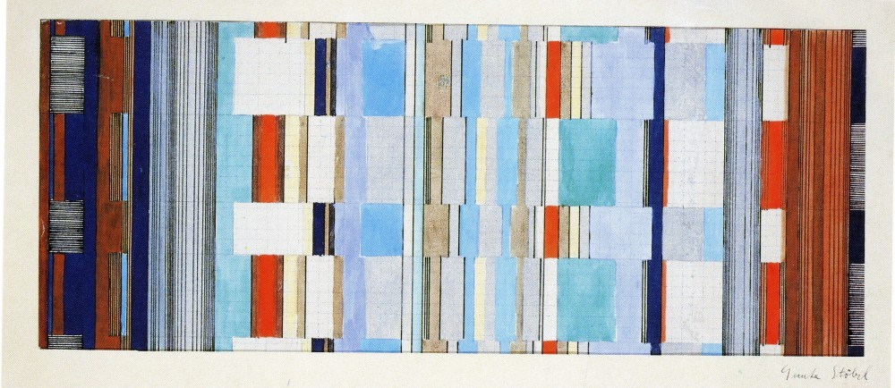
Gunta Stolzl (1897-1983)

Slide 10
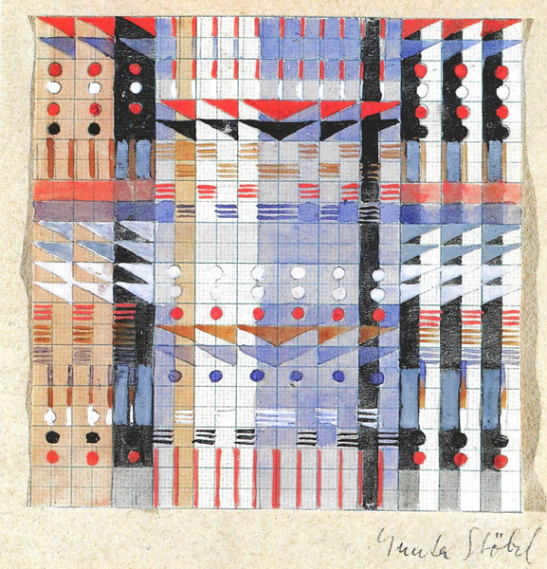

Slide 11
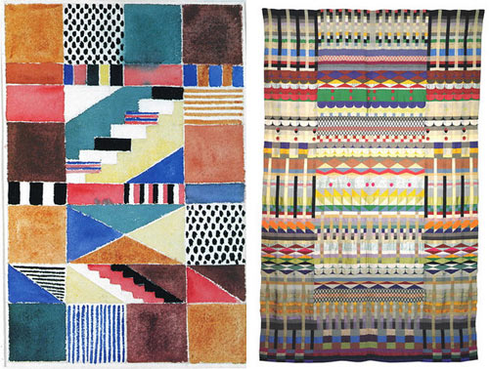

Slide 12
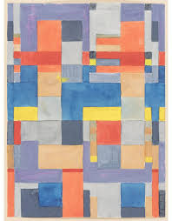

Slide 13
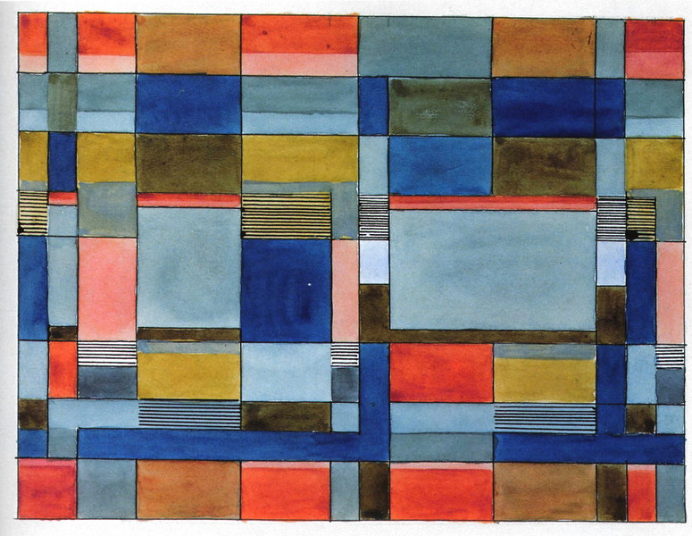

Slide 14
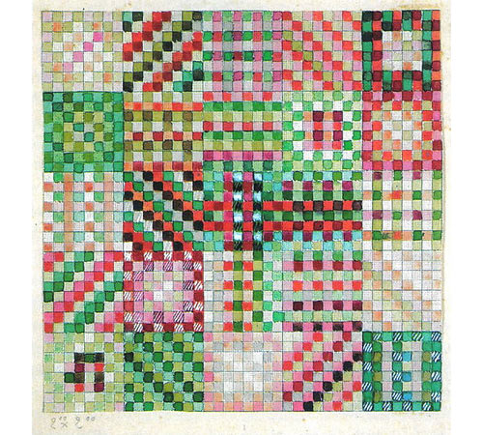

Slide 15
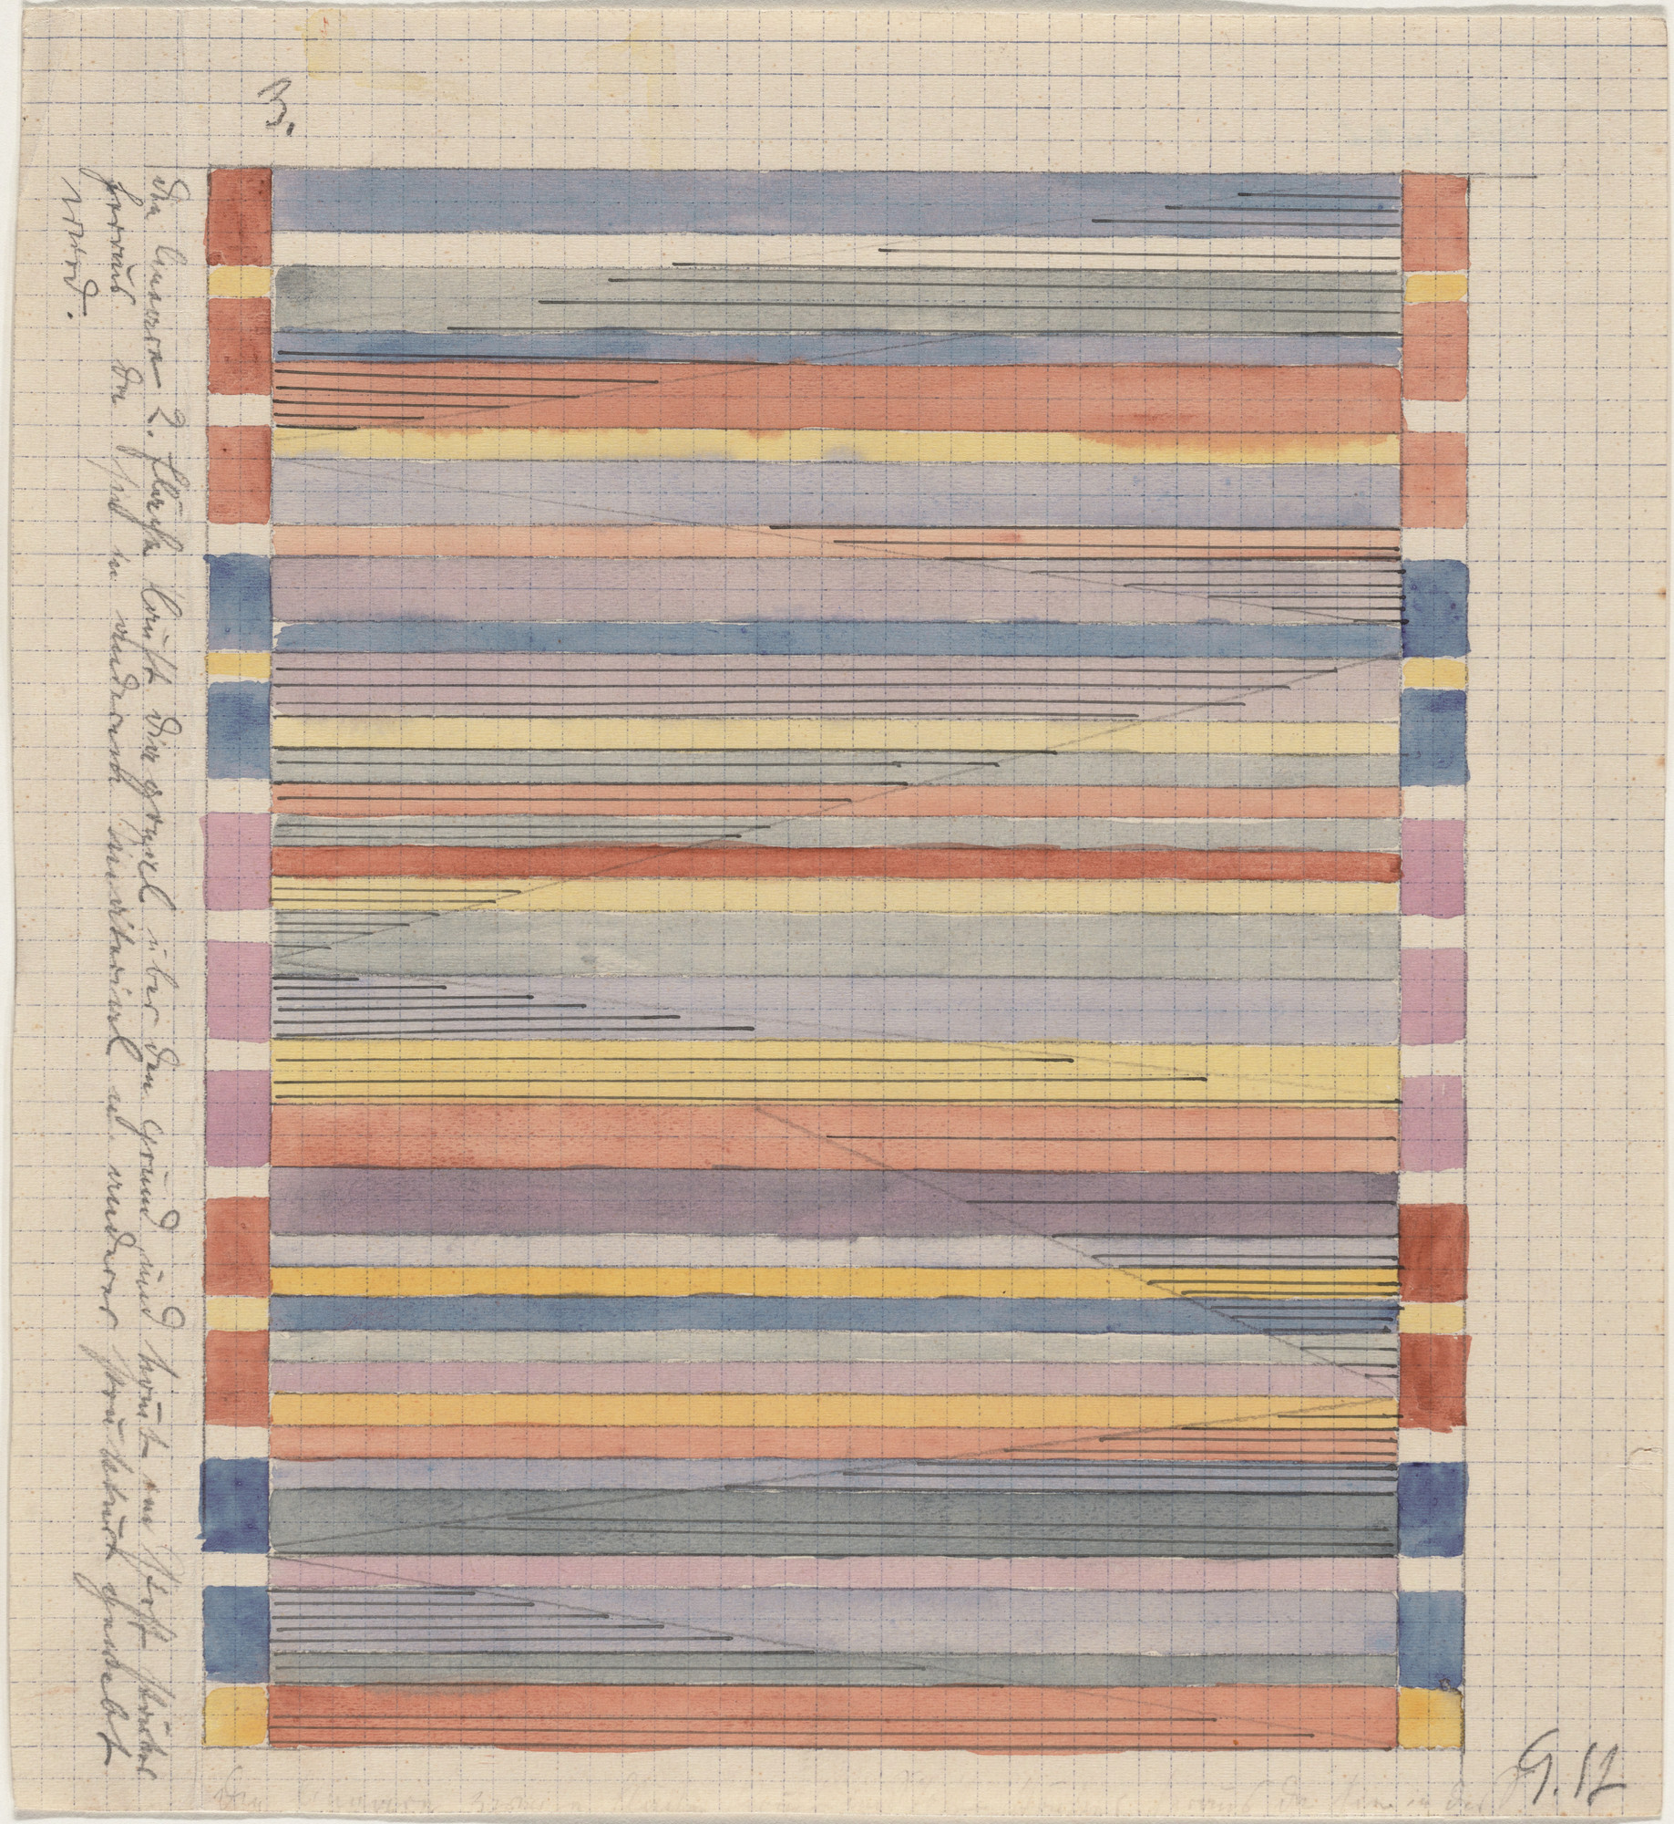

Slide 16
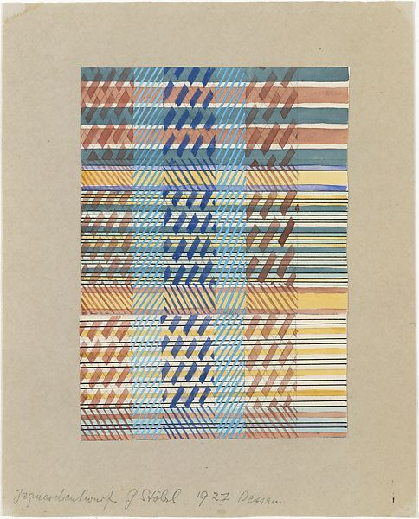

Slide 17
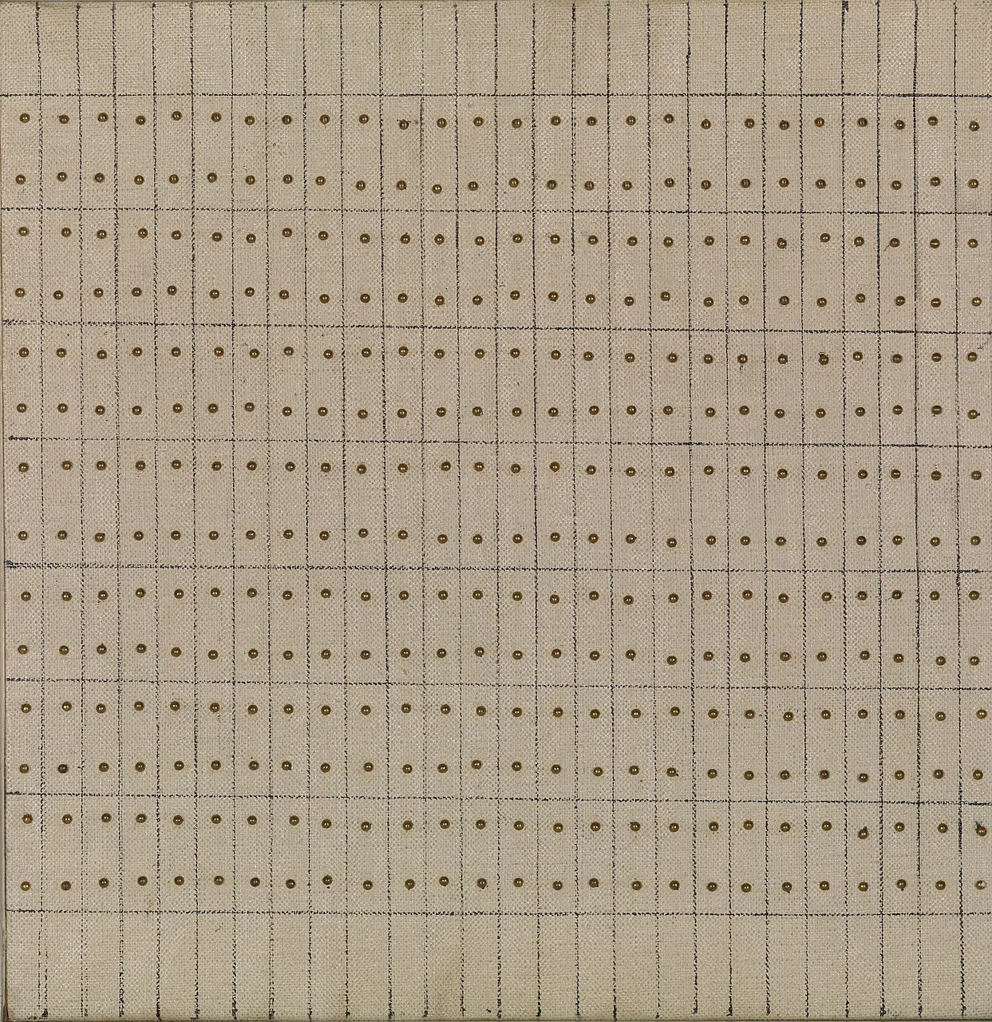
Agnes Martin
1912-2004

Slide 18
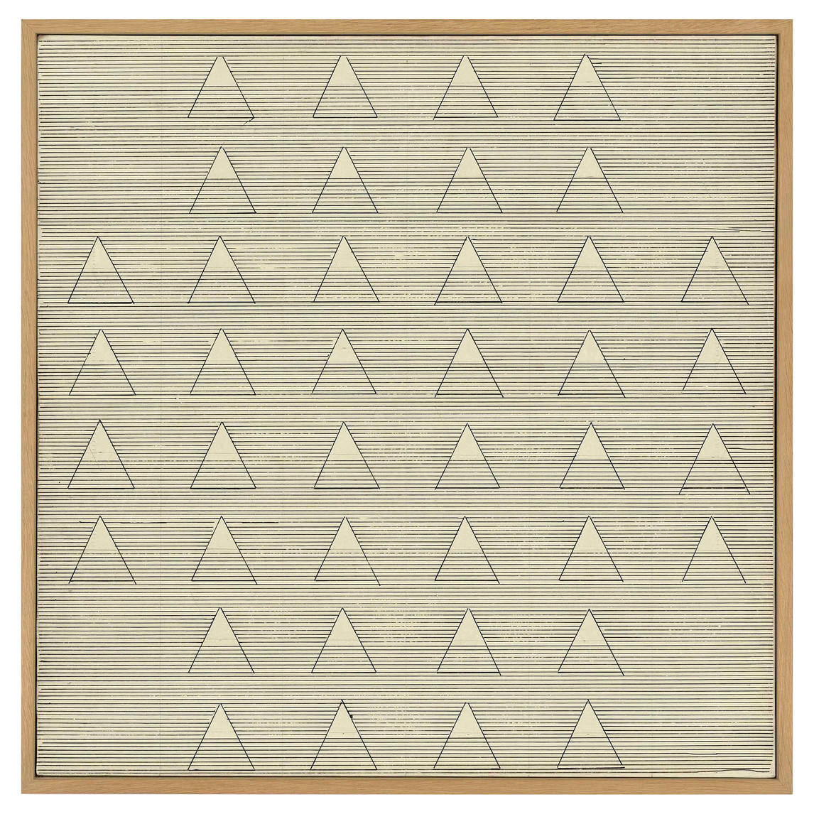

Slide 19
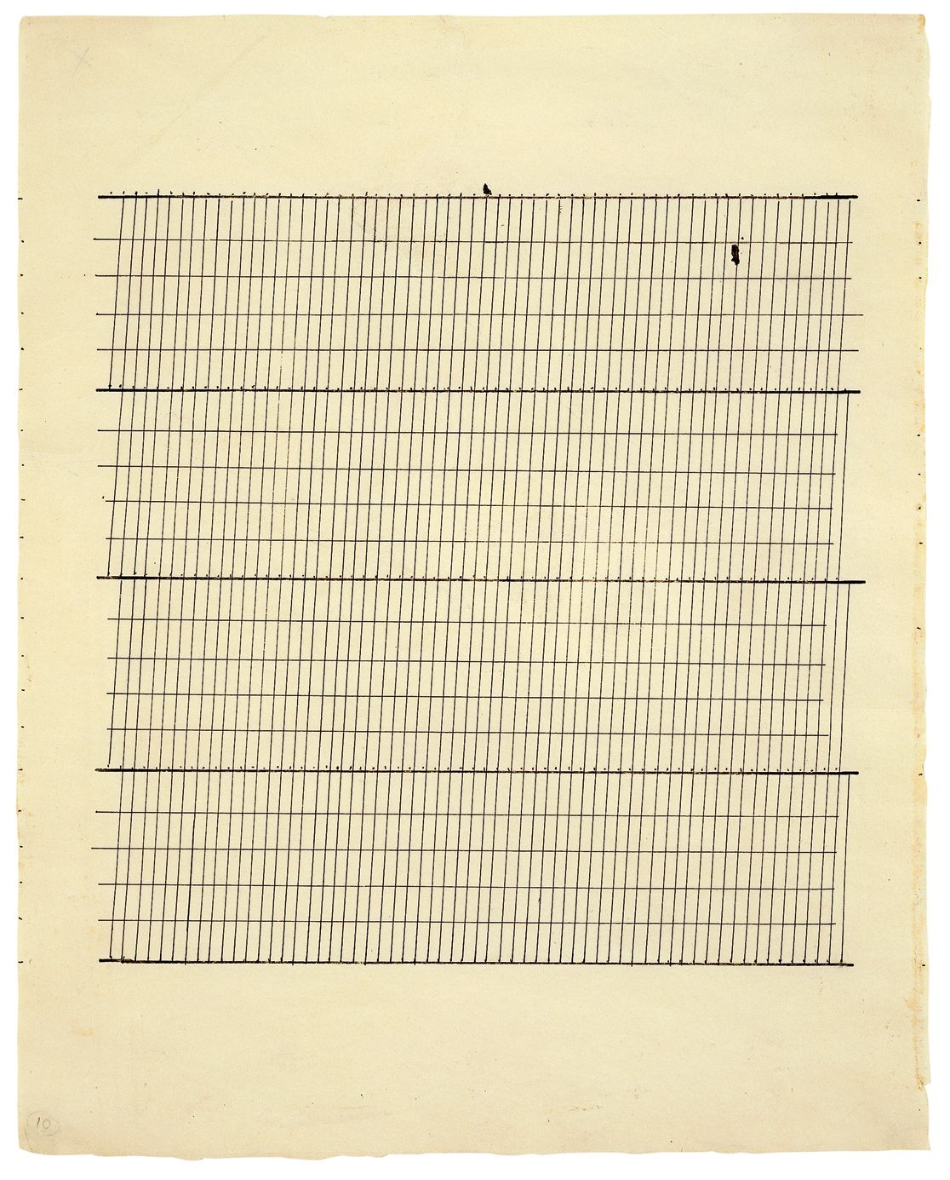

Slide 20
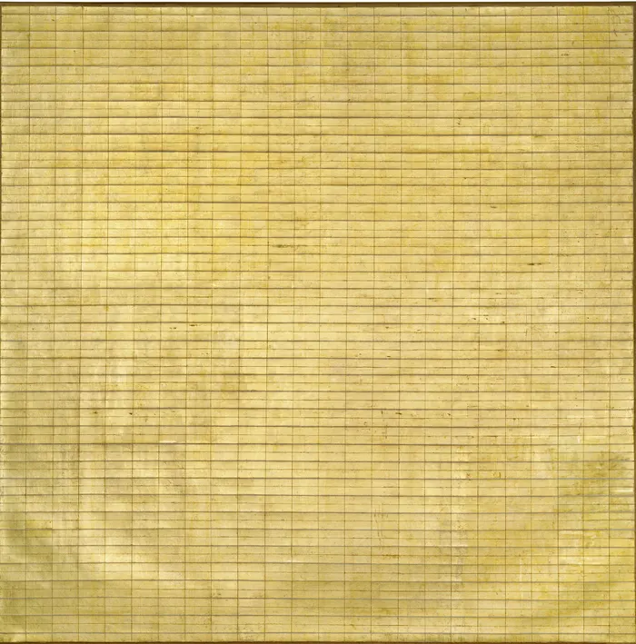

Slide 21
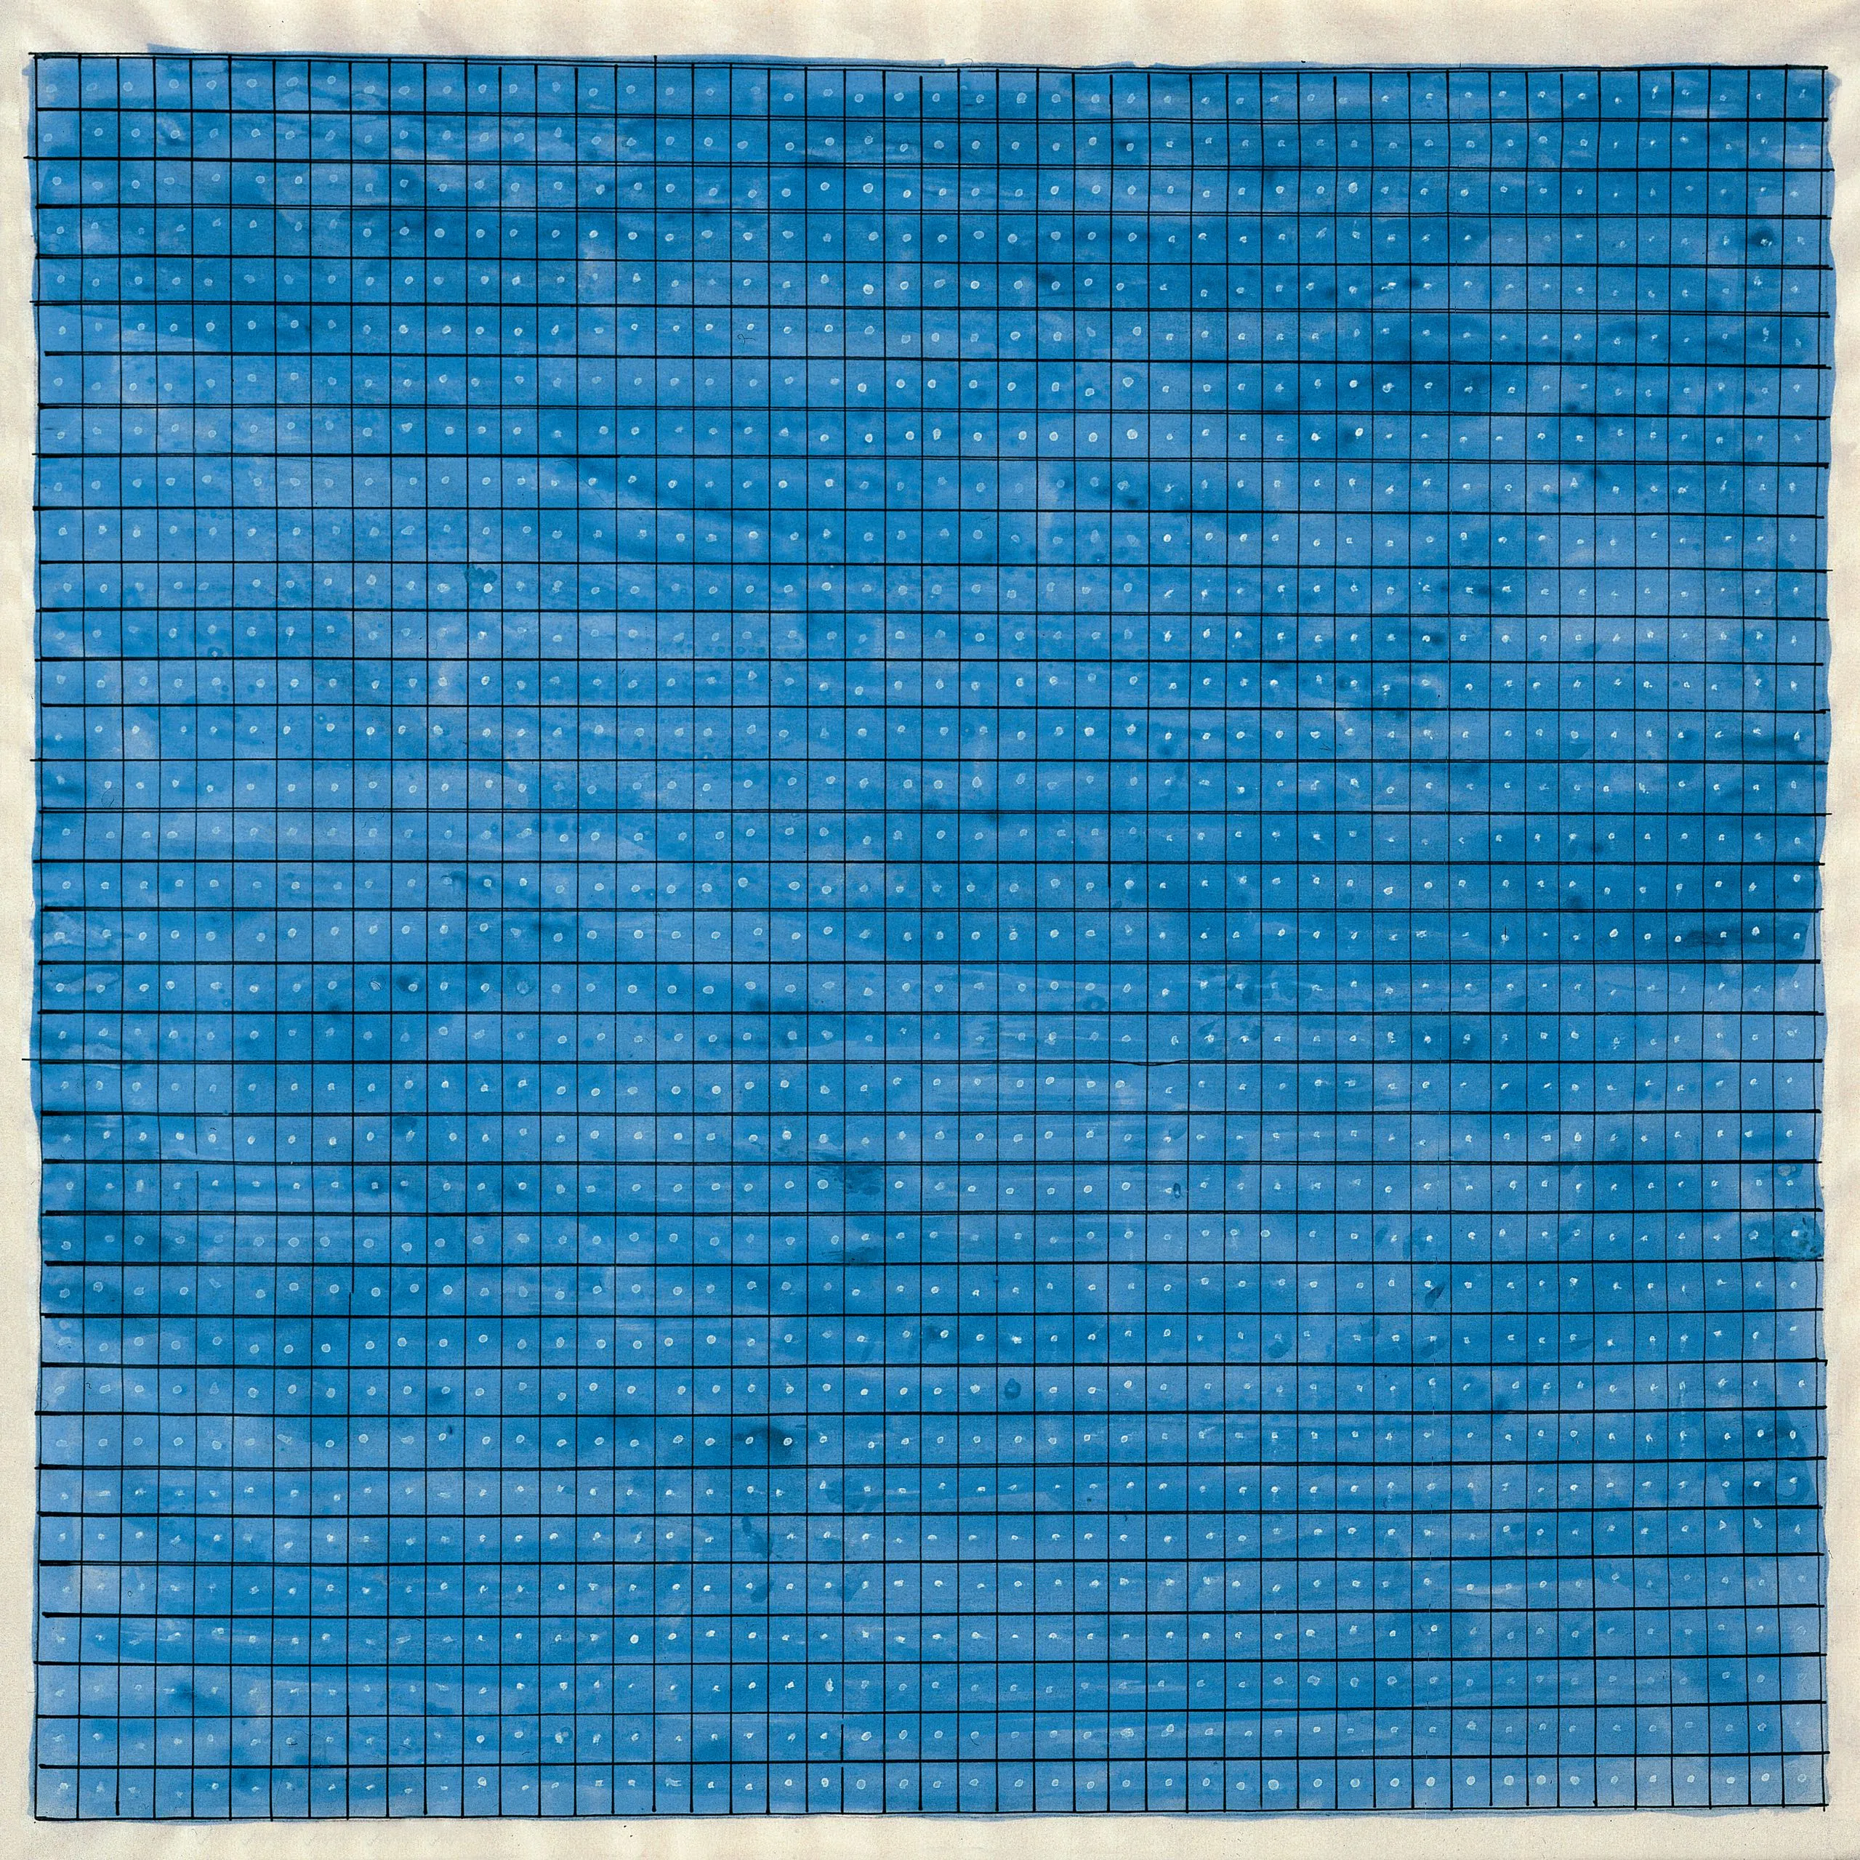

Slide 22
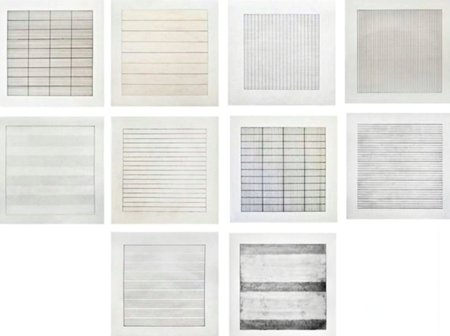

Slide 23
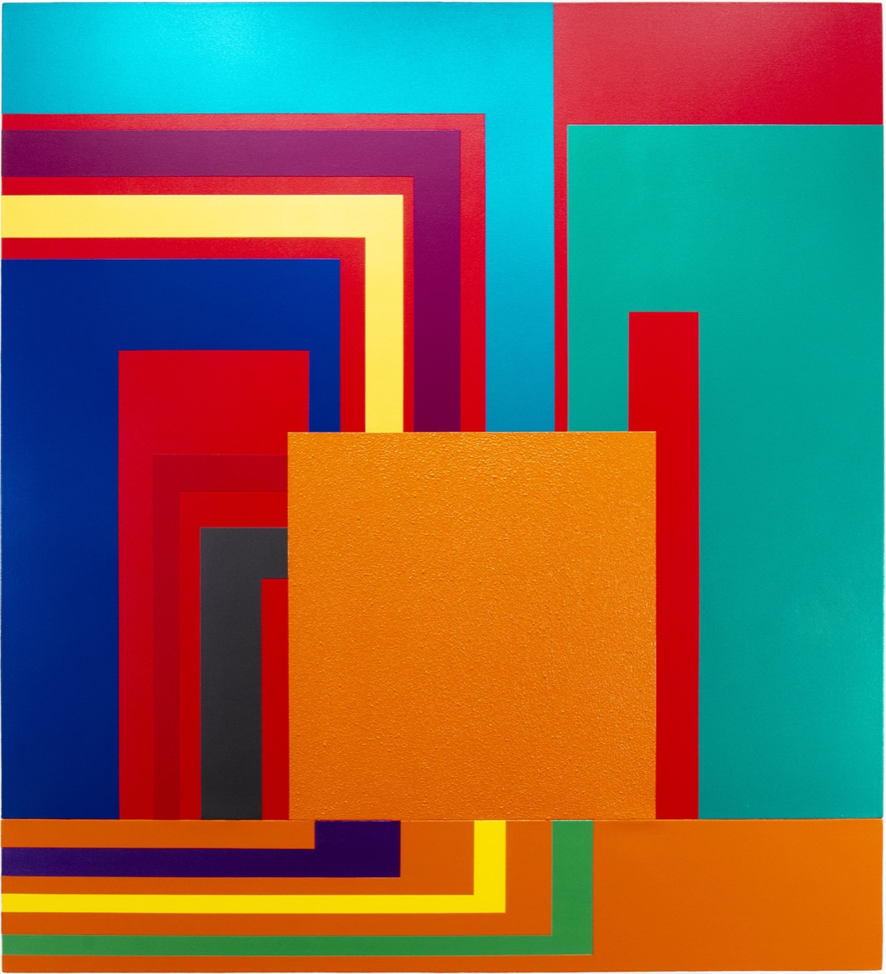
Peter Halley (1953-)

Slide 24
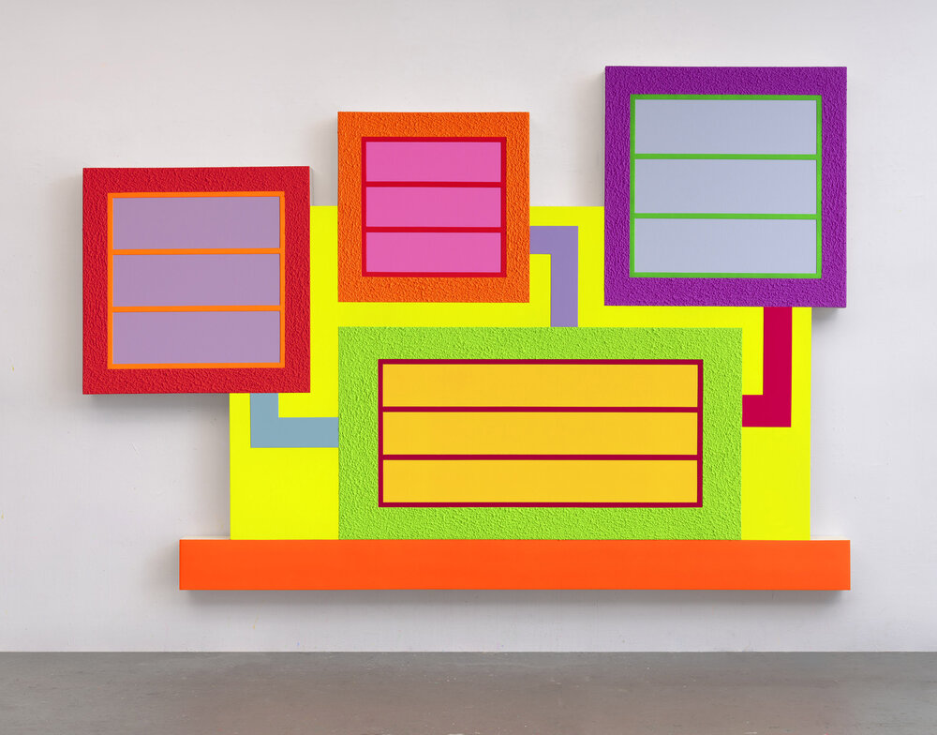

Slide 25
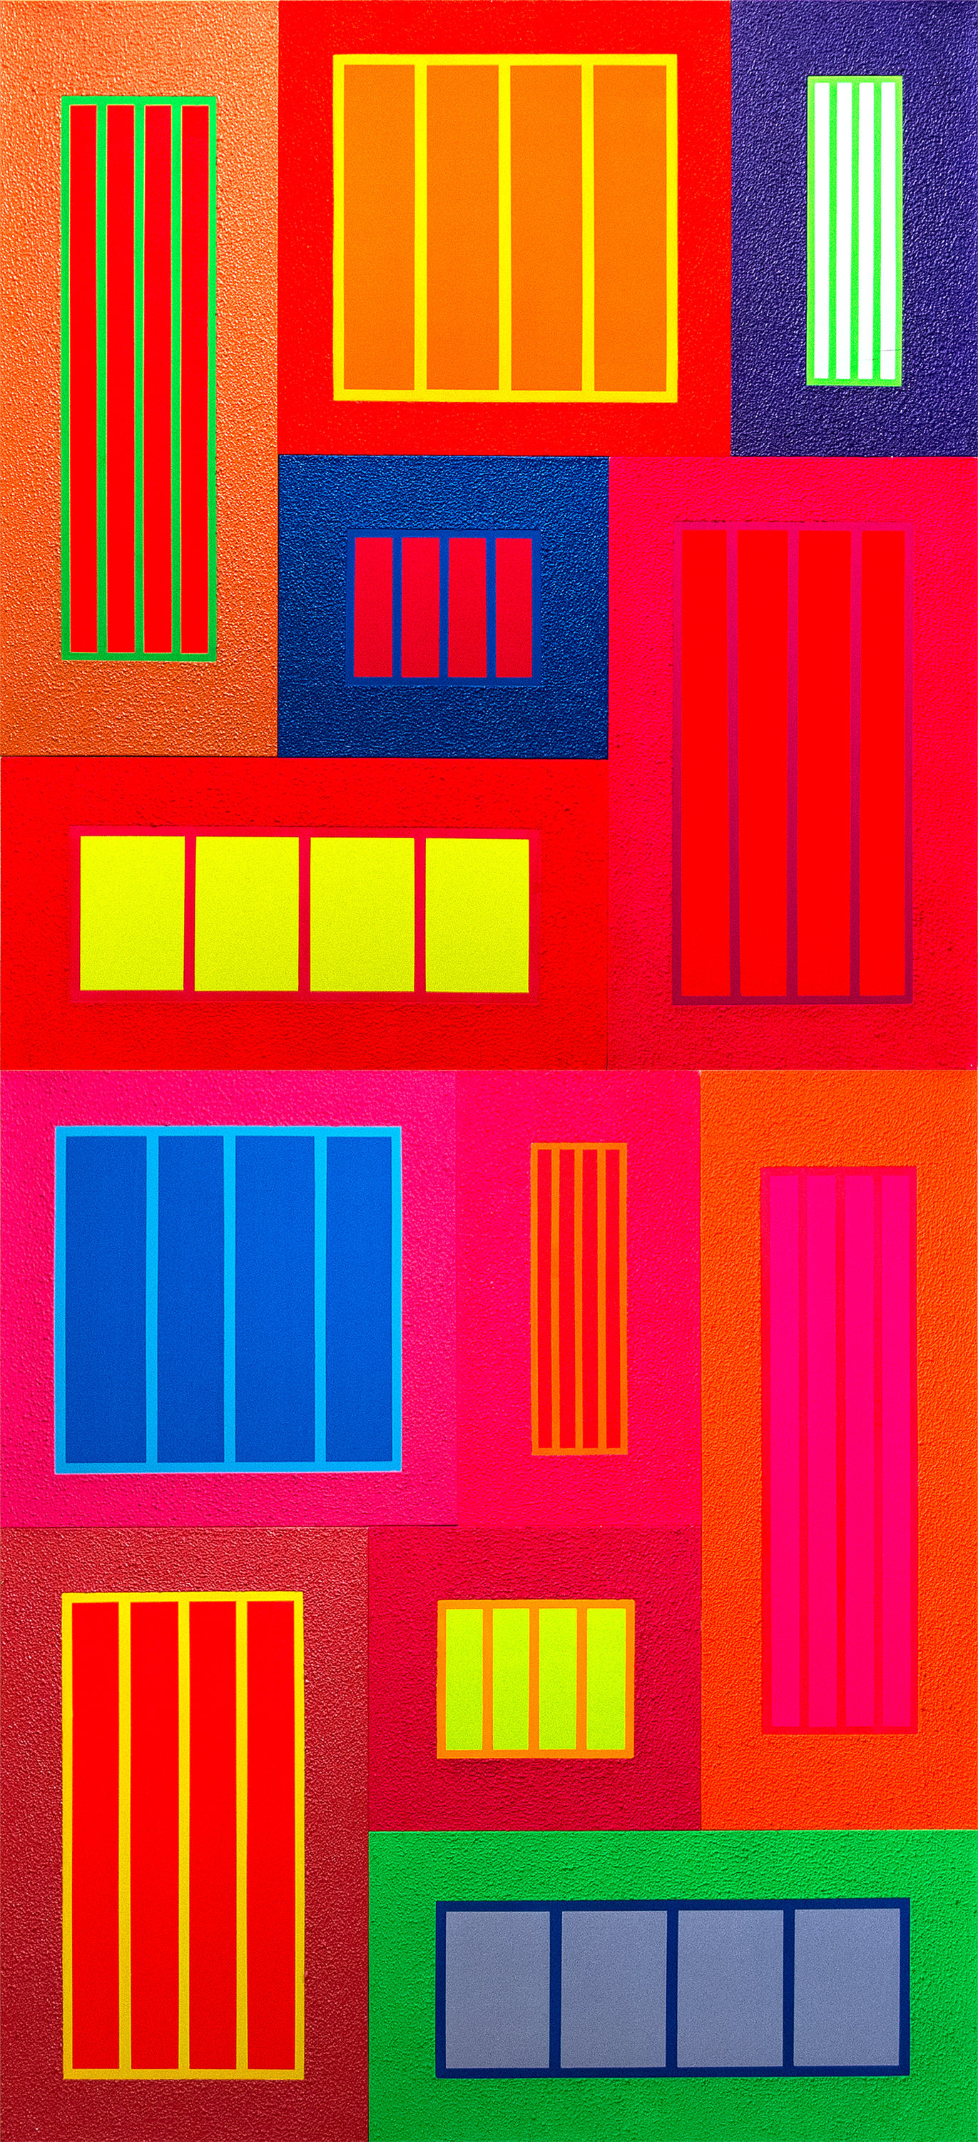

Slide 26
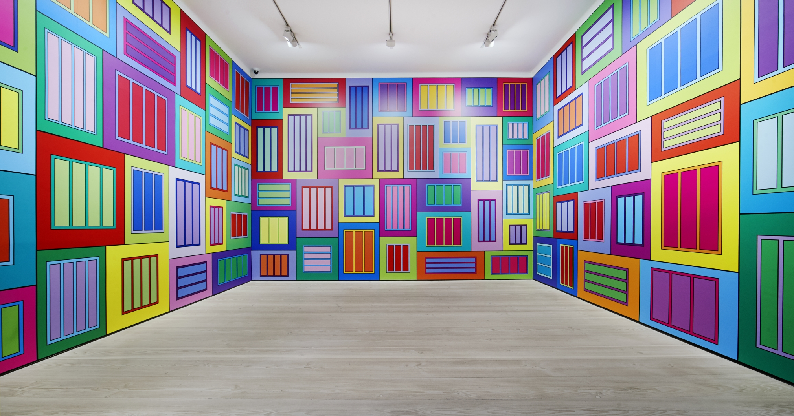

Slide 27
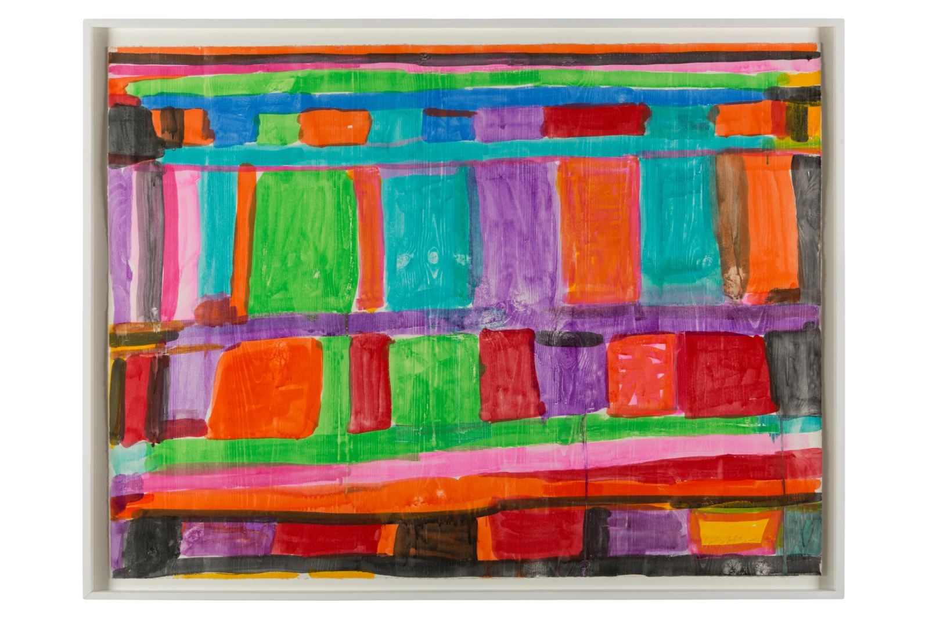
Stanley Whitney
1946-

Slide 28
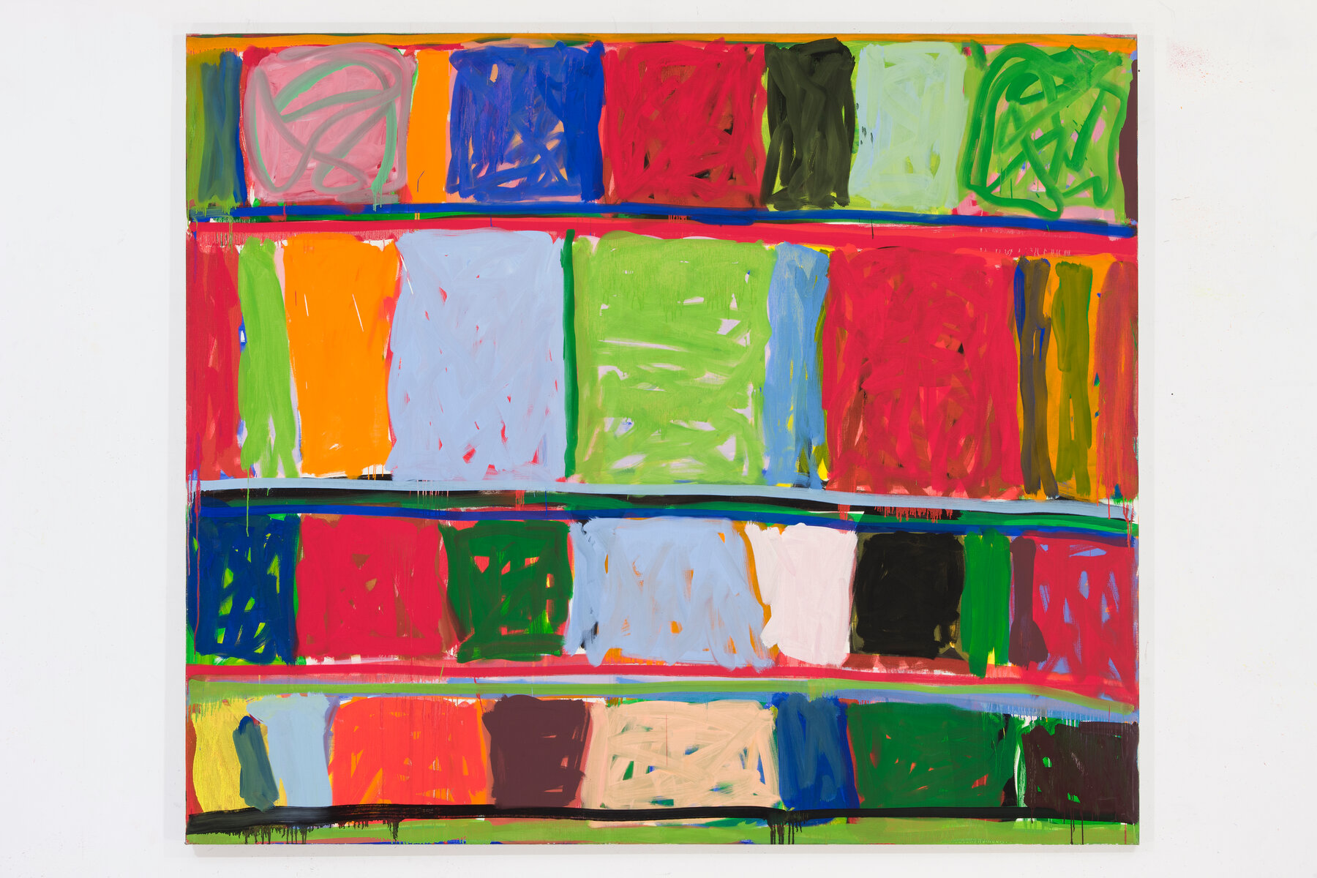

Slide 29
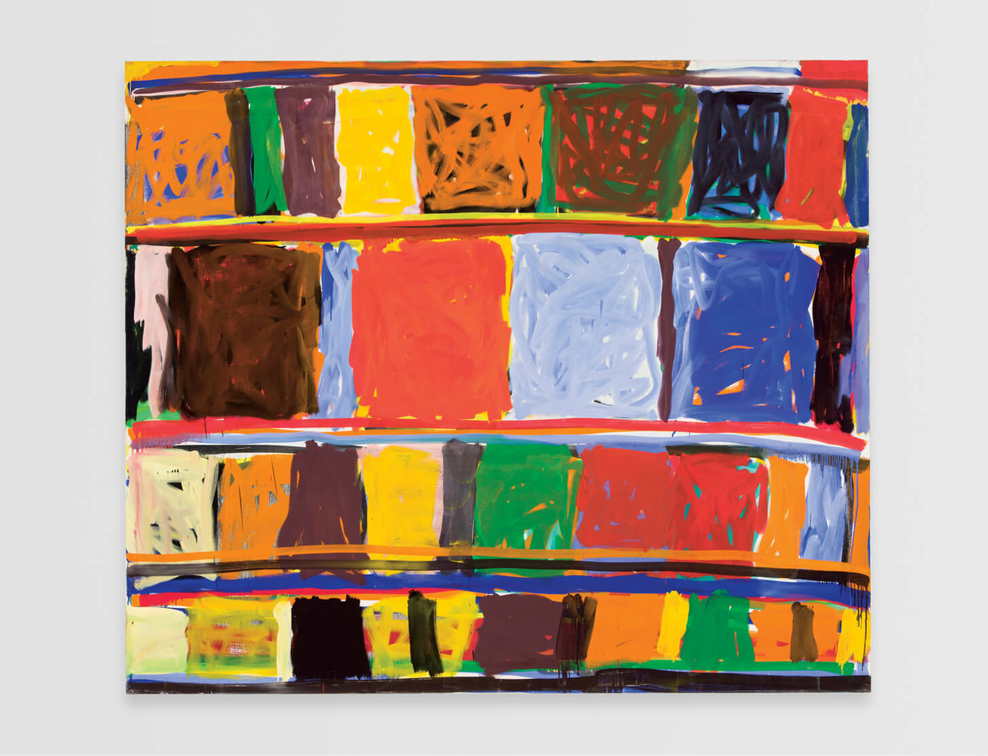

Slide 30
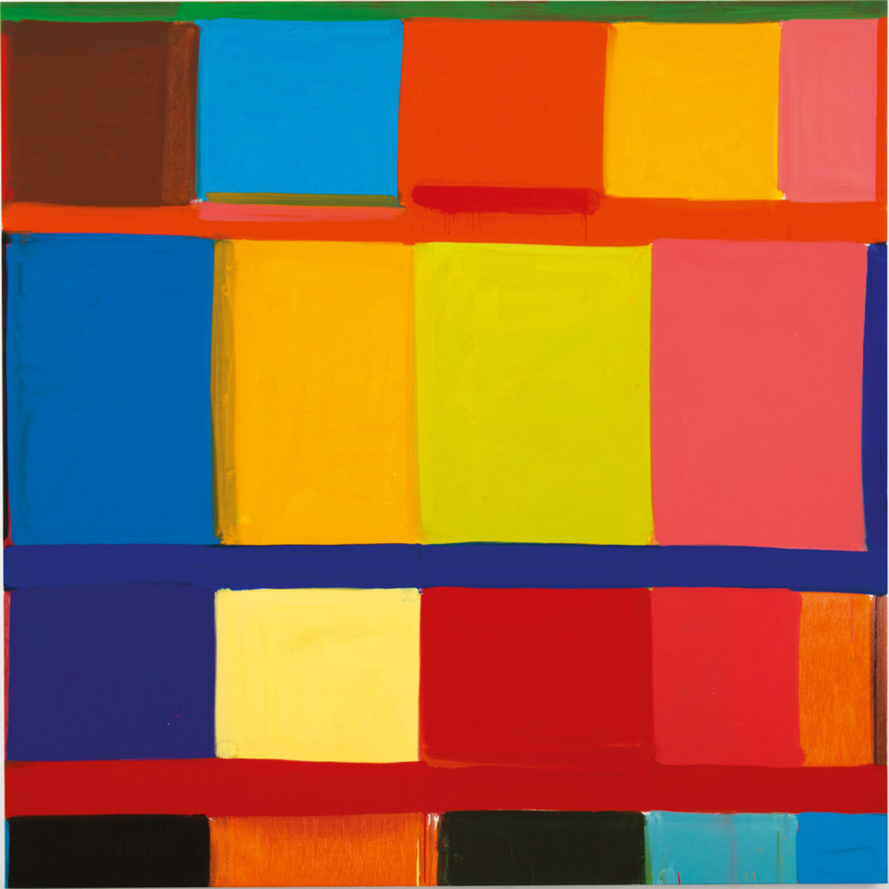

Slide 31
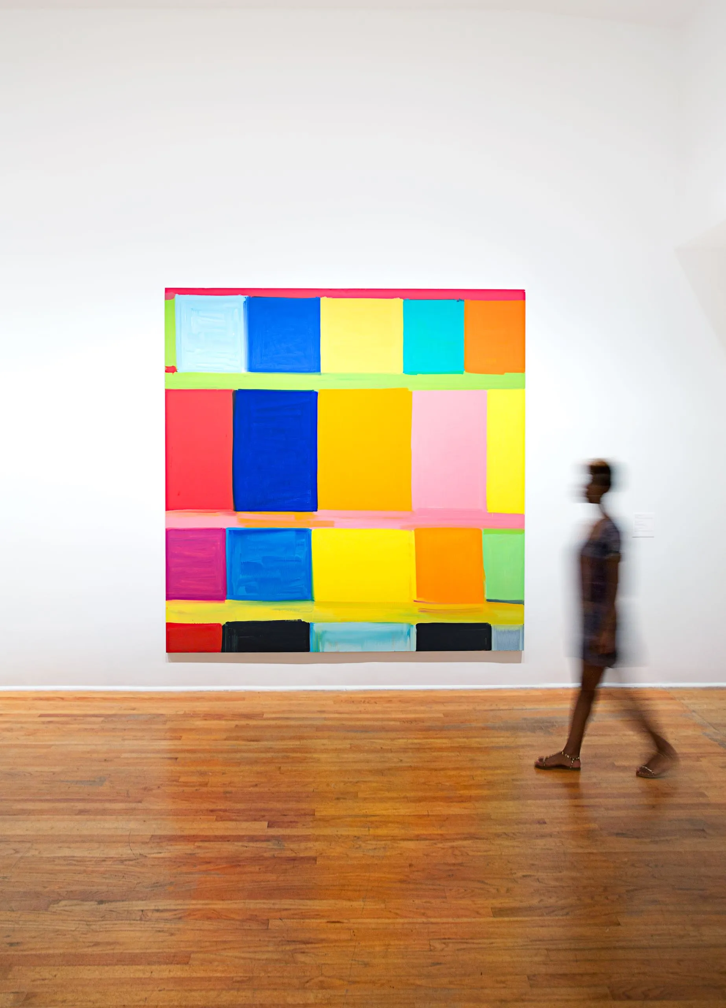

Slide 32
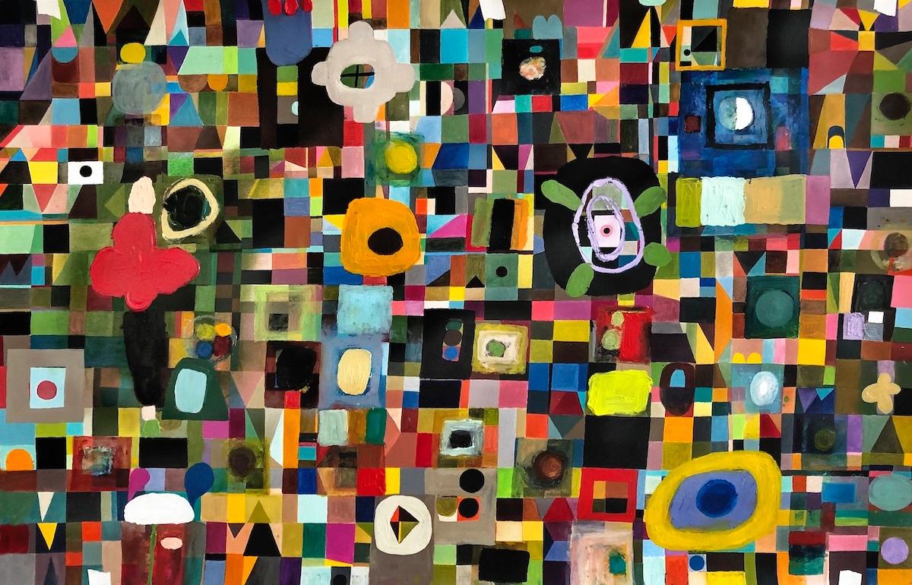
Ralph Lemon. (1952-)

Slide 33
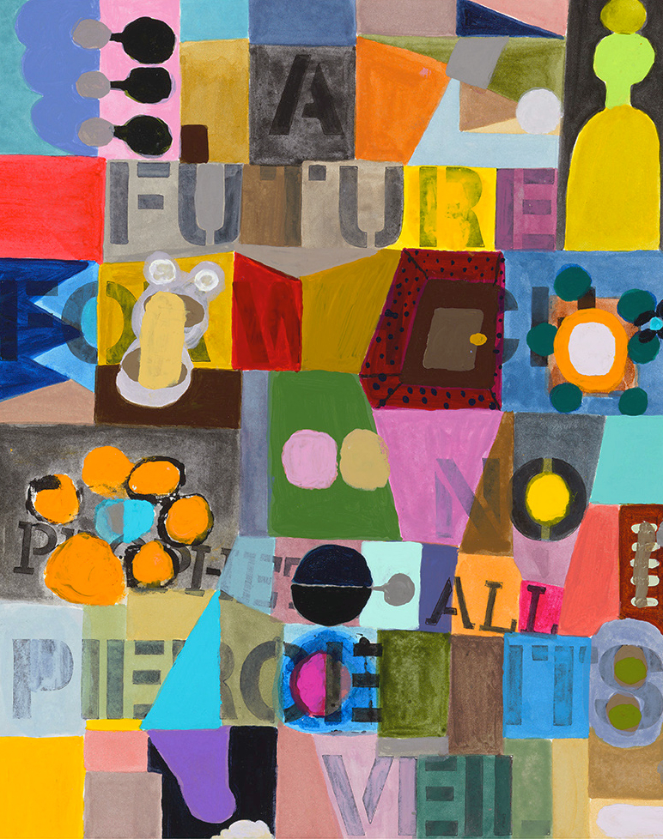

Slide 34
Colour Scheme 1 - Monochromatic Green
Green (straight from tube or cake)
Light green (add water)
Dark green 1 (add red)
Dark green 2 (add violet)
Gray green (add equal amount of red to the green)
Blue green (add blue)
Yellow green (add yellow)
Alternate green (blue and yellow

Slide 35
Colour Scheme 2 –Limited Palette (Primary and Secondary)
Primary Colours: red, blue and yellow
Secondary Colours: orange, violet and green
Choose ONE primary and TWO secondaries

Slide 36
Colour Scheme 3 Chromatic Grays
Mix chromatic grays using the following combinations
-blue + orange
-violet + yellow
-green + red
-black + any colour (you can try adding different colours to black to get a variety of darks
(Achromatic gray: black and white)

Slide 37
Colour Scheme 4 Low Key
Make a colour scheme based on dark colours:
Dark red, dark blue, dark green, dark gray
You can make colours dark by three ways
-using the complement (red/green, blue/orange)
-adding violet
-adding black

